Slide 1
Republic of Turkey
Ministry of National Education General Directorate for Vocational and Technical Education
Studies for Improvement and Development of Vocational Education
30 Nov. - 01 Dec. 2017
Turin

Slide 2
Studies for Improvement and Development of Vocational Education
By Legal Regulations on 2 December 2016;
Aprenticeship is in the compulsory education
Certificate of Mastership at the end of 4. year is given
Number of apprentices increased from 75.000 to 135.000
Notes:
9 Aralık 2016’da Yürürlüğe Giren 6764 Sayılı Kanun Kapsamındaki Düzenlemeler ile;
Çıraklık eğitimi zorunlu eğitim kapsamına alınmıştır.
Ortaokulu bitiren öğrenciler Ortaöğretim kademesinde ustalık eğitimi programlarına kaydolarak zorunlu eğitimlerini tamamlayabilmektedirler.
4 yıllık eğitim sonucunda ustalık belgesi verilmektedir.
Dramatik bir biçimde düşen çırak sayısı 75 binlerden 135 binlere yükselmiştir

Slide 3
Studies for Improvement and Development Vocational Education
Subsidy for Internship
Two thirds of minimum wage
Insurance Support
Insurance for occupational accidents and diseases
School Report
Evaluation 7 Theme and 70 indicators
Support for Private VET
70 schools 41,204 students

Slide 4
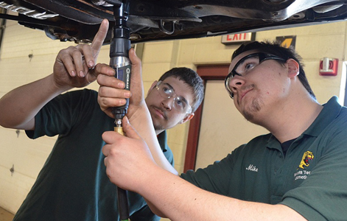
Studies for Improvement and Development Vocational Education
Thematic Vocational High Schools
Specializing in single field
Cooperation with sector
In-service education in work places
Cooperation with universities
48 ilde 6,268 teachers in 48 cities

Slide 5
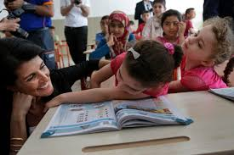
Studies for Improvement and Development Vocational Education
Syrian Students
Approximately 3.3 millions
Population in school age: 976 thousands
Enrolled students: 613 bin
VET: 3,842
LLL: 65,719

Slide 6
Problem Fields
Value given to VET,
Not to be supplied enough support by private sector,
High demand for higher education.

Slide 7
THANKS
Dr. Recep ALTIN
Head of Educational Policies Department

