Slide 1



Netherlands
Employer engagement in sectoral skills governance
Country case for the first PPT section Pasqualino Mare, ETF Senior Expert
knowledge centres
qualification files
regional delivery

Slide 2
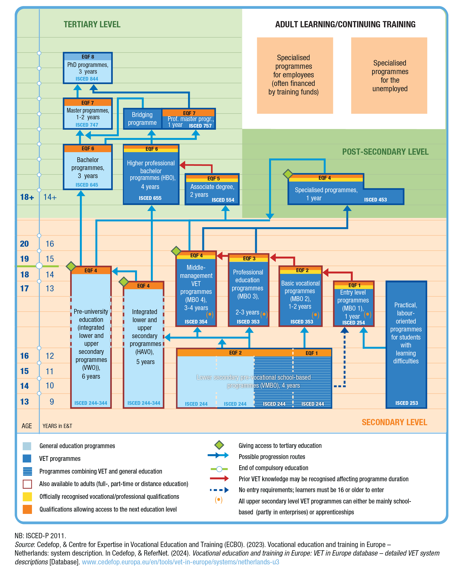
NETHERLANDS COUNTRY CASE
The Dutch model institutionalises employer engagement
Employer voice is built into a system — and made durable by the Dutch tradition of social dialogue — that turns sector input into qualification standards, labour-market intelligence and practical learning capacity.
1
Sector expertise
Employers and education actors define occupational requirements and keep them updated.
2
National coherence
A national qualification structure keeps standards portable and comparable.
3
Regional implementation
MBO colleges and accredited training companies deliver practice-based routes locally.

Slide 3
NETHERLANDS COUNTRY CASE
Why the model has worked in the Netherlands
Historical success factor
A long tradition of social dialogue (the “polder model”) means employers, trade unions and government are used to negotiating solutions together.
Institutions such as the SBB make tripartite consultation routine and legitimate; this carries over into the governance culture around skills and VET.
In vocational education, this supports shared development of qualifications, apprenticeships/work placements and skills anticipation.
As a result, employer engagement is systemic and continuous — less dependent on personal networks and more embedded in stable interfaces.
How social dialogue translates into success
Dialogue culture
Consensus-seeking, trust and predictable consultation
Trusted institutions
SER, SBB, MBO Raad and organised social partners
Concrete results
Qualification updates, labour-market intelligence and placement quality
This cultural foundation helps explain why Dutch employer engagement has been sustained over time.

Slide 4
NETHERLANDS COUNTRY CASE
1. Sector bodies work as knowledge centres
What makes the model concrete
SBB today consolidates many functions previously carried by sector knowledge centres.
Not only a forum for dialogue: SBB produces system inputs used by schools and companies.
Outputs include qualification structure maintenance, accreditation/coaching of work-placement companies, and labour-market intelligence.
This creates an evidence loop between sector demand, training capacity and qualification design.
Historical reference: COLO coordinated the former sector knowledge centres; since 2015, SBB has taken over key statutory tasks.
Employer / sector insight
Knowledge centre outputs
Qualifications & placements
Provider implementation

Slide 5
NETHERLANDS COUNTRY CASE
Where sector chambers sit inside SBB
Core role
Sector Chambers are the sectoral governance interface between organised business and vocational education within SBB.
SBB Board
Receives advice and takes decisions within SBB governance
Nine Sector Chambers
Education and business meet at sector level; members are nominated by umbrella organisations and appointed by the SBB Board.
Qualification structure
Maintaining qualification, microcredentials.
Work placements
Accreditation, quality and availability of WBL, internships and apprenticeships.
Market Segments
Branch-level and programme-level expertise feeds the sector chambers.
Labour-market information
Sector data and intelligence on shortages, surpluses and emerging skills.
Alignment
Connecting education supply with sector and regional labour-market needs.
The nine chambers cover fields such as entry-level training, trade, ICT/creative industry, mobility/logistics, specialist craft, technology/built environment, food/green/hospitality, business services/safety, and care/welfare/sport.

Slide 6
NETHERLANDS COUNTRY CASE
What sector chambers do
Their value is not only dialogue
They convert sector expertise into system inputs that SBB and the VET Schools field can use.
Qualifications & examinations
Discuss sectoral questions on qualifications and examination issues; advise on maintaining the national qualification structure.
Work-based learning
Signal issues around placements and apprenticeships; support quality and availability of accredited training companies.
Efficiency & relevance
Review whether training provision connects to labour-market demand and regional or sectoral needs.
Labour-market intelligence
Use sector analyses, employer signals and SBB data to anticipate shortages, surpluses and occupational change.
Interpretation
Sector Chambers are a structured entry point for employer and provider input: they shape advice and decisions, while curricula remain the responsibility of VET institutions.
Sources: MBO Raad “Sectorkamer”; SBB “Sectorkamers en marktsegmenten”; SBB “Advisering en besluitvorming”.

Slide 7
NETHERLANDS COUNTRY CASE
Market Segments and Sector Chambers: two levels of input
Simple distinction
Market Segments provide detailed branch-level and occupational input. Sector Chambers translate this into broader sectoral advice within SBB.
Market Segments
Technical / sub-sector layer Branch and occupation-level expertise Signals from programmes, companies and regions
Sector Chambers
Strategic sectoral governance layer Parity-based education-business table Advice on qualifications, WBL and labour-market alignment
feed into
How to explain it in one sentence
Market Segments are the detailed intelligence layer; Sector Chambers are the formal governance layer that turns this intelligence into SBB advice and decisions.
Sources: SBB “Sectorkamers en marktsegmenten”; MBO Raad “Sectorkamer”.

Slide 8
NETHERLANDS COUNTRY CASE
How sector input becomes action
Process logic
Sector Chambers sit in the middle of a flow from labour-market signals to formal SBB advice and practical implementation.
1 Signals
Employers, branches, MBO colleges and regions identify changes in jobs, technology and placement supply.
2 Market Segments
Branch-level groups bring concrete developments and expertise onto the agenda.
3 Sector Chamber
Education and business discuss the issue in a sectoral, parity-based setting.
4 SBB Board
Receives advice on statutory tasks and system-wide coordination.
5 Implementation
Qualification updates, WBL action, labour-market information and regional provision decisions.
Key point
The chamber does not replace schools or ministries. It creates a formal interface where sector evidence is translated into advice that SBB can act on.

Slide 9
NETHERLANDS COUNTRY CASE
Why Sector Chambers matter for employer engagement
Governance lesson
They provide a durable mechanism for translating employer voice into usable skills-system outputs.
1
Built into the system
Employer input is not ad hoc: it enters through formal tables, Market Segments and SBB statutory processes.
2
Knowledge-centre function
Chambers use sector analyses, labour-market data and practical WBL signals to build shared intelligence.
3
Clear division of roles
Employers influence qualification content and work-based learning; VET institutions design and deliver curricula.
Country-case message
SBB Sector Chambers show how employer engagement can be institutionalised as a repeated, evidence-based governance process — not merely consultation.
Sources: SBB and MBO Raad public materials; SEOR sector analyses page for use of sector analysis by SBB Sector Chambers.

Slide 10
NETHERLANDS COUNTRY CASE
2. Employers influence curricula through qualification files
Clear roles prevent capture and keep education providers responsible for pedagogy.
Employers & sectors
SBB qualification files
MBO (VET) colleges
Students & firms
Define occupational requirements and signal skills needs.
Translate requirements into national qualification dossiers.
Formulate curricula and teaching plans on the basis of files.
Apply learning through internships / apprenticeships in accredited firms.
Interpretation for sectoral governance: employers do not own curricula, but they have structured entry points into the qualification content that shapes curricula.

Slide 11
NETHERLANDS COUNTRY CASE
3. National coordination + regional delivery
Why this matters for fast-moving sectors
National layer aligns standards, data and qualification updates across sectors.
Regional/local layer connects MBO (VET) colleges and training companies to investment patterns and labour-market demand.
This is especially relevant for energy, transport, logistics, construction and digital transitions.
National coordination
SBB / qualification structure
Institutional bridge: MBO Raad represents VET colleges; SBB links vocational education and business around qualifications, exams and work placement.
Regional delivery
MBO colleges + firms
Interface: where sector intelligence becomes practical provision

Slide 12
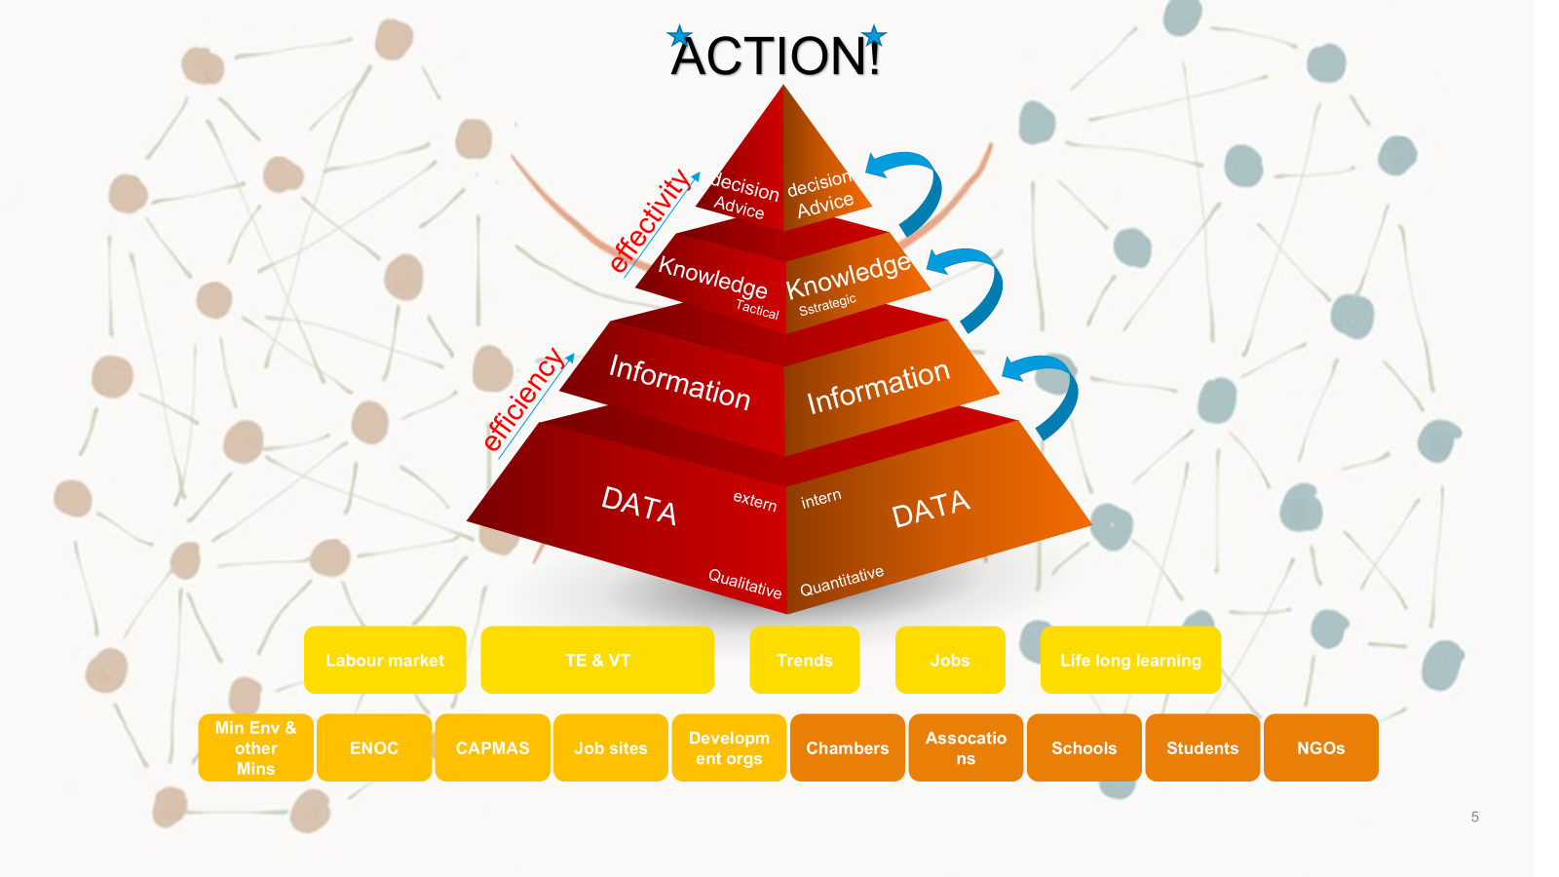
NETHERLANDS COUNTRY CASE
From data to intelligence, knowledge and decision
Why this matters in the Dutch system
Raw data only becomes useful when an intermediary turns it into labour-market intelligence.
SBB aggregates labour-market data, employer signals and work-placement information.
Dialogue with employers and providers turns intelligence into shared knowledge on occupations and skills needs.
This informs decisions on qualification updates, regional provision, company accreditation and priority-setting.
This is why sector bodies add most value when they act as knowledge centres rather than dialogue platforms alone.

Slide 13
NETHERLANDS COUNTRY CASE
Implications for sector skills councils
Lessons to carry forward
1
Build institutions around outputs
Prioritise skills intelligence, occupational profiles, qualification updates and placement standards over dialogue alone.
2
Define interfaces with curricula
Employers influence requirements; providers translate them into teachable curricula.
3
Combine sector + place
National coordination keeps coherence; regional delivery keeps the system responsive to investment geography.
Bottom line
The Dutch example shows a mature model: employer engagement works because institutions produce concrete outputs and because a long tradition of social dialogue gives these arrangements trust, legitimacy and continuity.

