Slide 1
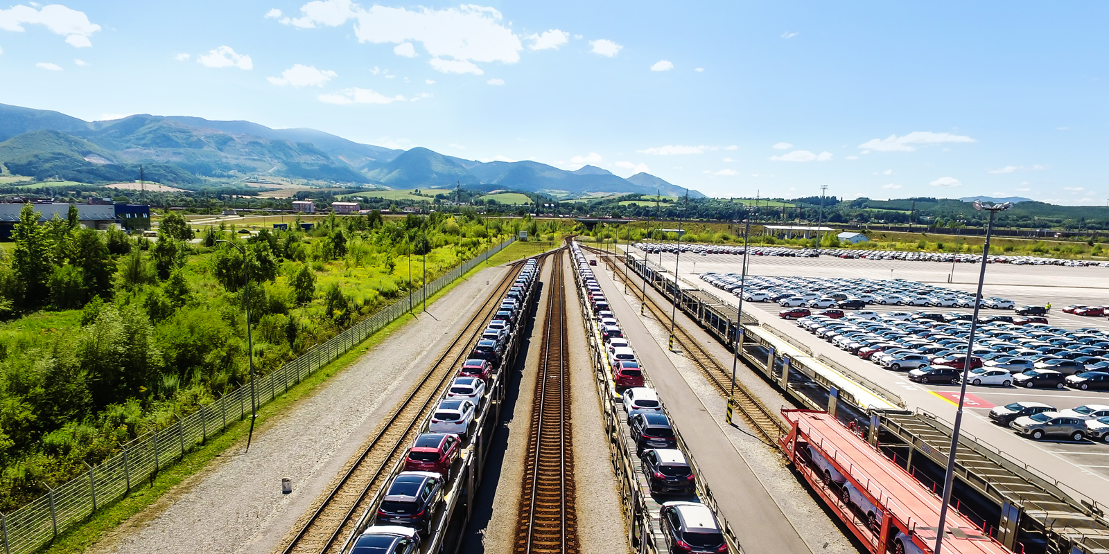
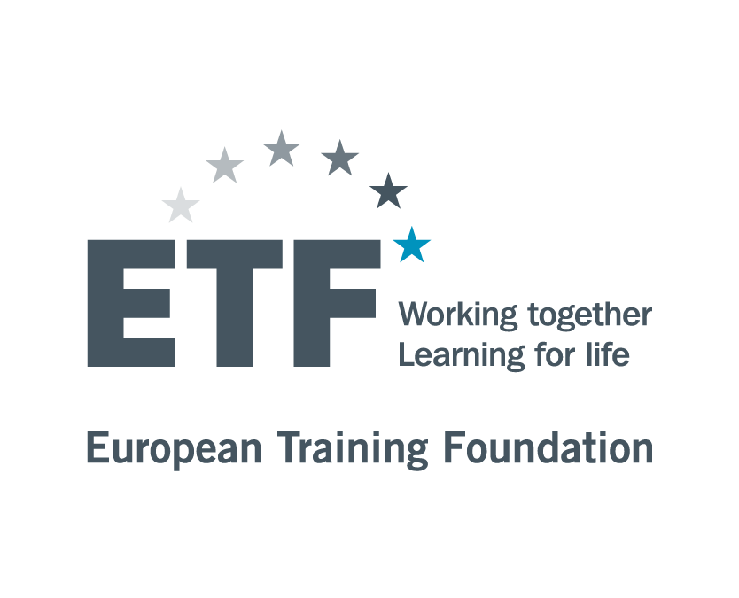

Build trust in Skills Systems: What Slovakia´s Automotive Sector Teaches us

Slide 2
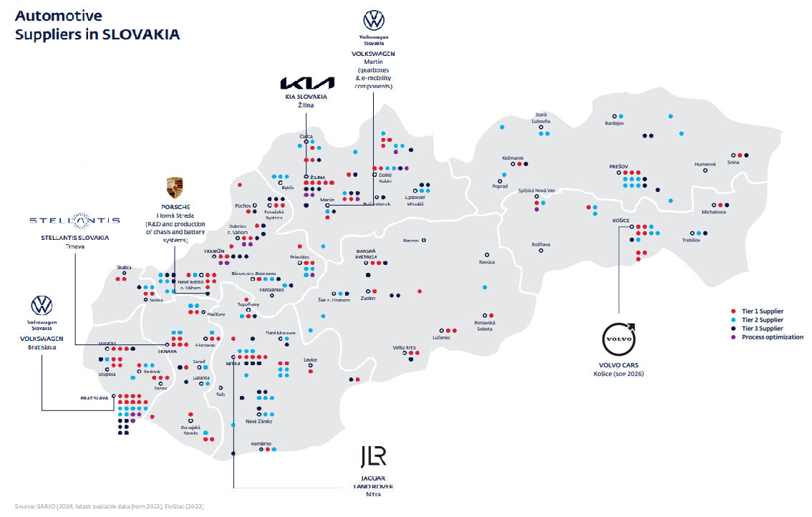
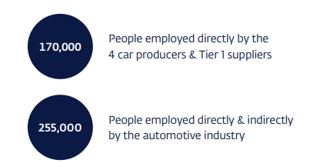
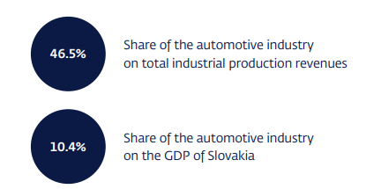
Why SLOVAKIA?

Slide 3
Technical education in automotive sector in Slovakia
Involvement in training provision (focus- digitalisation and robotics).
University and research partnerships: Slovak University of Technology, Technical University of Kosice, and University of Zilina on applied research, internships, customized degree tracks that bolster mechatronics, robotics, and safety engineering
MATADOR presented the super sports hydrogen concept MH2 at the prestigious exhibition TOP MARQUES MONACO - MATADOR Group
Innovation/Mobility labs: Sectors - Innovate Slovakia
Modular and micro-credentials: Concise, skills-focused certifications to support internal career progression in areas such as robotic operation, automotive electronics, or paint-shop safety
Digital training tools: Virtual reality (VR) and augmented reality (AR) deliver immersive safety simulations—hazard detection, emergency evacuation, lockout-tagout training—without exposing learners to real-world risks, while e-learning systems and mobile applications offer just-in-time instruction for shift teams.
Reskilling and transition programs: When automation reduces the need for repetitive tasks, companies help employees retrain for roles in maintenance, quality control, or programming
Education level | Number | Enrolled students | Graduates
Higher level education | 32 Technical and IT faculties | 28 000 | 6000
Automotive related VET | 174 Automotive Related Technical VET schools | 31 000 | 8000
Dual education scheme- 190+ vocational schools already established cooperation with more than 1,900 companies around Slovakia
Employers bring new R&D related skills demand (automation specialists, robotics engineers, digital data skills, EV and battery expertise) and support
In 2025, Uzbekistan signed a cooperation memorandum with Slovak recruitment firms such as Manpower Group Slovakia to supply workers for major automotive plants, including Volkswagen Slovakia, Stellantis, Volvo and Jaguar Land Rover.

Slide 4
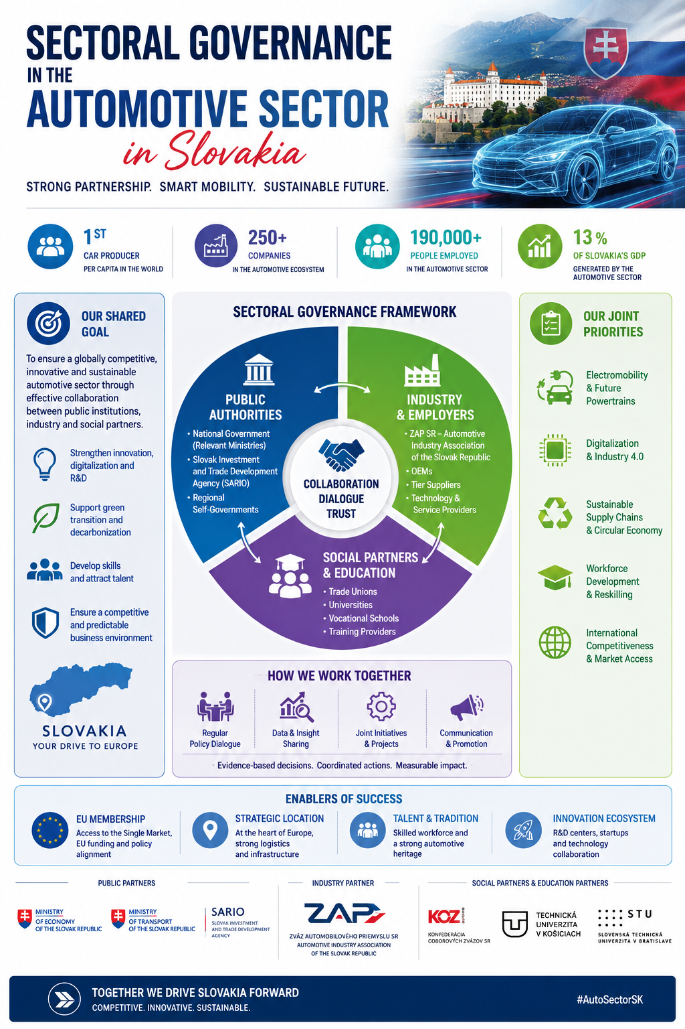
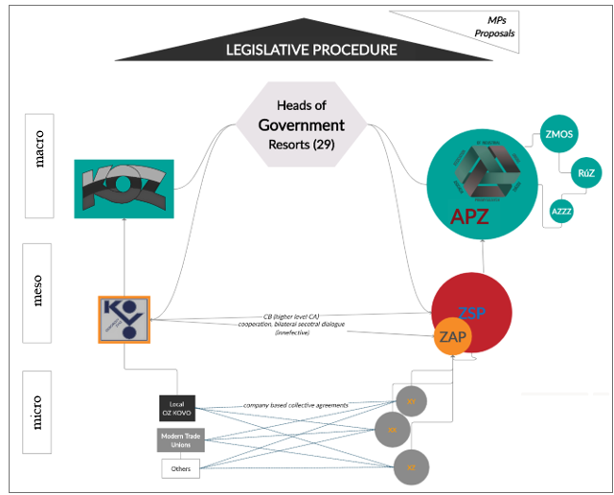

Slide 5
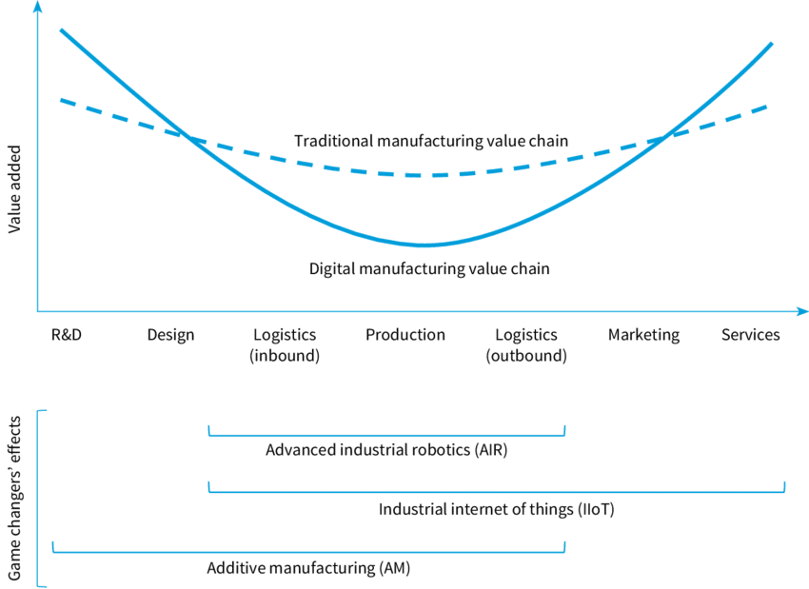
Digitalisation (Industry 4.0) has put the model in real test...
“With gradual robot deployment in production, 36% of jobs would disappear…” (Pravda, 2016)
“Automation is already advancing rapidly in industry and could lead to the loss of 30–40% of jobs.” (TREND.sk, 2018)
“Robotisation threatens about one-third of jobs in Slovakia — with 151 robots per 10,000 workers, compared to a global average of 85.” (SME.sk, 2020)
Notes:
Here a good instrument to look at is smiling curve. We see here two manufacturing value chain lines, one is the solid line- the digital manufacturing value chain and we see that the higher value is added at the initial and final steps of the production chains. So firstly in RnD, design and then a the end- the selling activities, marketing, services, logistics, whereas the value added in production activities is the lowest. This contrast to the traditional manufacturing value chain, where the value added in production has been higher, so it has ben more evenly distributed.
Based on GVC literature, the CEE has been described as so called “ integrated periphery”, which means that it is integrated well in the global production networks, but still rather at the low end. The competitive advantages of these countries has been mostly in low labour costs, high share of manual work, relatively high low shares of work in the value creation, but still significant presence of multinationals in these countries, which increases the vulnerability of these countries to relocation or non integration or being kind of kept out of the future integration of value chains that have much higher value added. However GVC concept admit so called upgrading, or in other words shift towards the activities with higher value, the process is determined by interaction between firms, multinational corporations, as well as social partners like state, trade unions, employers’ organizations and others (Martiskova, 2018).
Question: So if our countries are moving from the dotted line to the solid line and so it means the value added in production is decreasing, then the question is what should these different sets of actors do about it, what kind of policies there should be in terms of education, skills and more importantly what should trade unions do to tackle this issue.

Slide 6
Two key messages
Slovakia shows how large foreign investment can rapidly scale sectoral development- in this case manufacturing — but the quality of outcomes depends on how employers are integrated into skills governance (dual VET, sector councils, employer associations)
The investments also depend on the trust of investors in the skills development system and its quality. Systems with functioning employer engagement mechanisms at different levels of skills formation (from anticipation and identification of skills needs to provision) instil more trust among investors. Ministries and governments role comes into question to provide incentives for trust.

