Slide 1

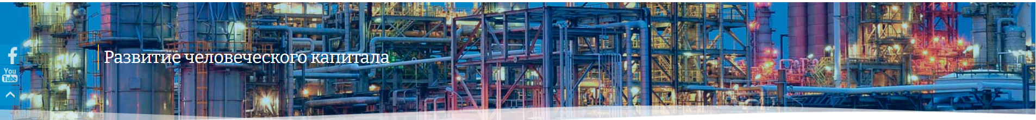
Human Capital Development
The Role of Sector Skills Councils in Kazakhstan
About the Sector Skills Council in the Energy Sector
The Role of KAZENERGY in the Sector Skills Council
Lyazzat Akmurzina
Executive Director of the KAZENERGY Association
Astana, 2026

Slide 2
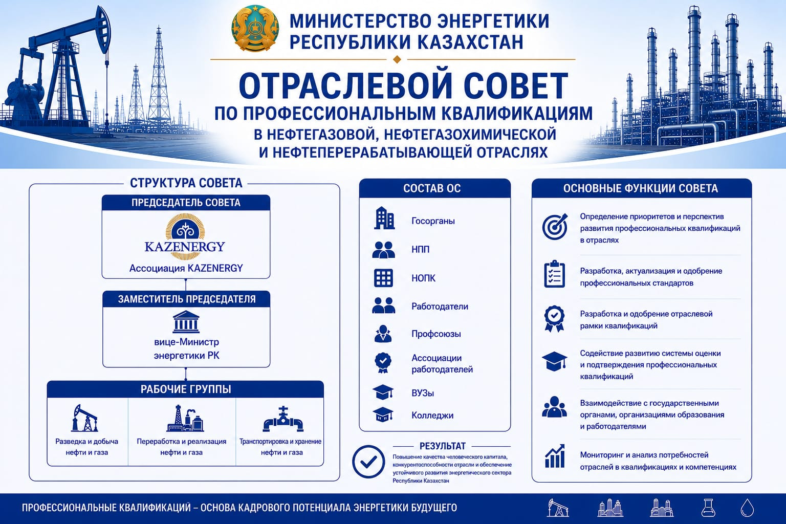
MINISTRY OF ENERGY
OF THE REPUBLIC OF KAZAKHSTAN
SECTOR SKILLS COUNCIL
FOR PROFESSIONAL QUALIFICATIONS
IN THE OIL AND GAS, PETROCHEMICAL
AND OIL REFINING INDUSTRIES
STRUCTURE OF THE COUNCIL
COMPOSITION OF THE SSC
KEY FUNCTIONS OF THE COUNCIL
CHAIR OF THE COUNCIL
Government agencies
Identifying priorities and development prospects for professional qualifications in the industries
National Chamber of Entrepreneurs
KAZENERGY Association
National Qualifications Body
Developing, updating and approving occupational standards
DEPUTY CHAIR
Employers
Developing and approving the sectoral qualifications framework
Trade unions
Vice Minister of Energy of the Republic of Kazakhstan
Supporting the development of the system for assessment and certification of professional qualifications
Employers’ associations
WORKING GROUPS
Higher education institutions
Colleges
Cooperating with government bodies, education providers and employers
Oil and Gas Exploration and Production
Oil and Gas Processing and Marketing
Oil and Gas Transportation and Storage
RESULT
Monitoring and analysing industry needs for qualifications and competencies
Improving the quality of human capital, enhancing industry competitiveness and ensuring the sustainable development of the energy sector of the Republic of Kazakhstan
PROFESSIONAL QUALIFICATIONS - THE FOUNDATION OF THE FUTURE ENERGY WORKFORCE POTENTIAL
Слайд №1

Slide 3
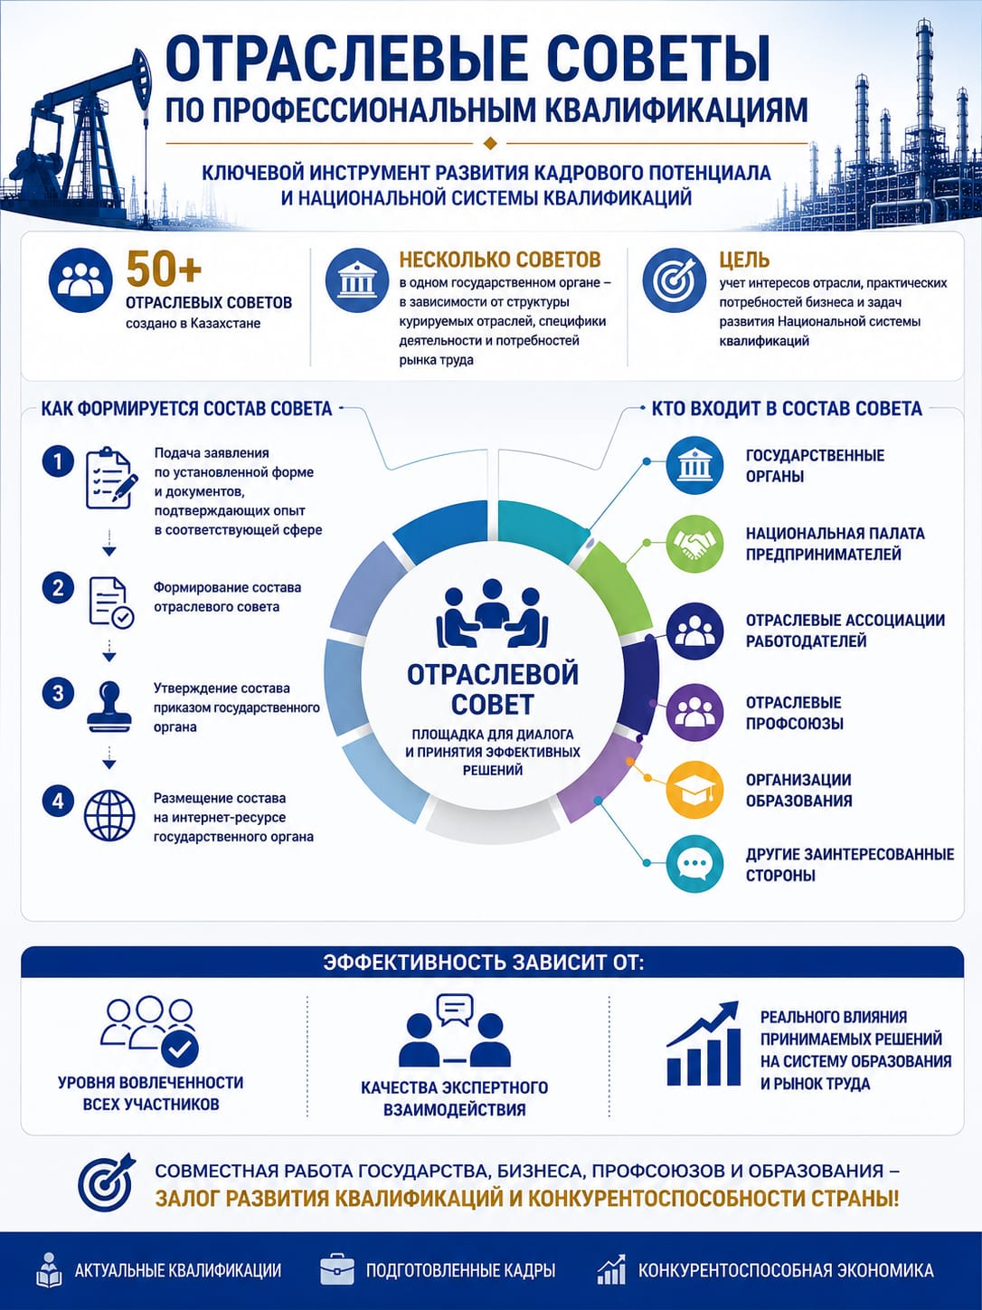
THE ROLE OF SECTOR SKILLS COUNCILS IN KAZAKHSTAN
Several councils
Objective
may operate within one government body depending on the structure of the supervised industries, sector-specific activities and labour market needs
to take into account industry interests, practical business needs and the objectives of developing the National Qualifications System
SECTOR SKILLS COUNCILS ESTABLISHED IN KAZAKHSTAN
HOW THE COUNCIL MEMBERSHIP IS FORMED
WHO IS INCLUDED IN THE COUNCIL
Submission of an application in the prescribed format and supporting documents confirming experience in the relevant field
Government bodies
National Chamber of Entrepreneurs
Formation of the Sector Skills Council membership
Sectoral employers’ associations
Approval of the membership by an order of the government body
SECTOR SKILLS COUNCIL
Sectoral trade unions
A platform for dialogue and effective decision-making
Publication of the membership on the government body’s online resource
Education providers
Other interested stakeholders
EFFECTIVENESS DEPENDS ON
The real impact of decisions made on the education system and labour market
The level of engagement of all participants
The quality of expert interaction
Slide №2

Slide 4
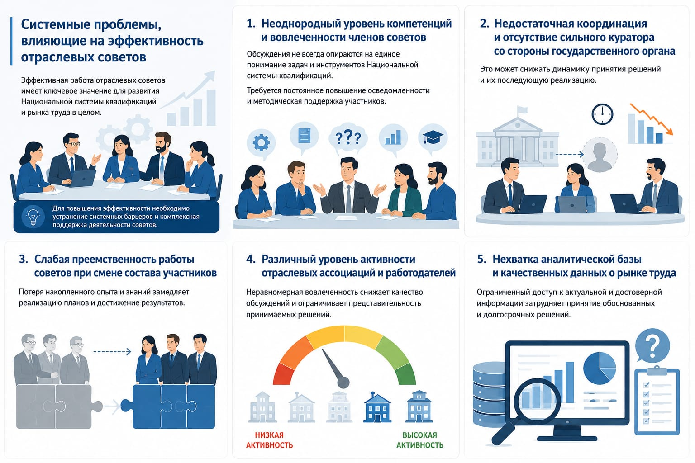
THE ROLE OF SECTOR SKILLS COUNCILS IN KAZAKHSTAN
Systemic challenges affecting the effectiveness of Sector Skills Councils
Uneven levels of competence and engagement among council members
Insufficient coordination and lack of strong stewardship from the government body
Discussions are not always based on a common understanding of the objectives and instruments of the National Qualifications System.
Continuous awareness-raising and methodological support for participants are required
The effective functioning of Sector Skills Councils is of key importance for the development of the National Qualifications System and the labour market as a whole.
This may reduce the pace of decision-making and hinder subsequent implementation
To improve effectiveness, it is necessary to address systemic barriers and provide comprehensive support for the activities of the council
Weak continuity in the work of councils when membership changes
Varying levels of activity among sectoral associations and employers
Lack of an analytical evidence base and high-quality labour market data
The loss of accumulated experience and knowledge slows down the implementation of plans and the achievement of results
Uneven engagement reduces the quality of discussions and limits the representativeness of decisions taken.
Limited access to up-to-date and reliable information complicates evidence-based and long-term decision-making.
Low activity
High activity
Slide №3

Slide 5
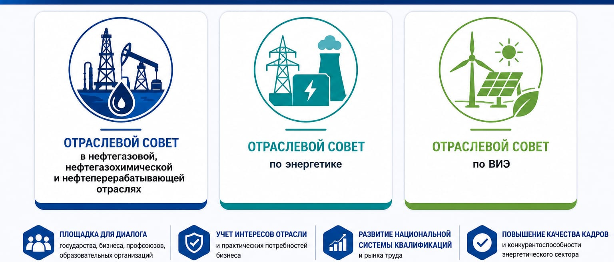
ABOUT THE SECTOR SKILLS COUNCIL IN THE ENERGY SECTOR
Sector Skills Council
Sector Skills Council
Sector Skills Council
for the oil and gas, petrochemical and oil refining industries
for the energy sector
for renewable energy sources
PLATFORM FOR DIALOGUE
CONSIDERATION OF INDUSTRY INTERESTS
DEVELOPMENT OF THE NATIONAL QUALIFICATIONS SYSTEM
IMPROVING WORKFORCE QUALITY
between government bodies, businesses, trade unions and education providers
and practical business needs
and the competitiveness of the energy sector
and the labour market
Slide №4

Slide 6
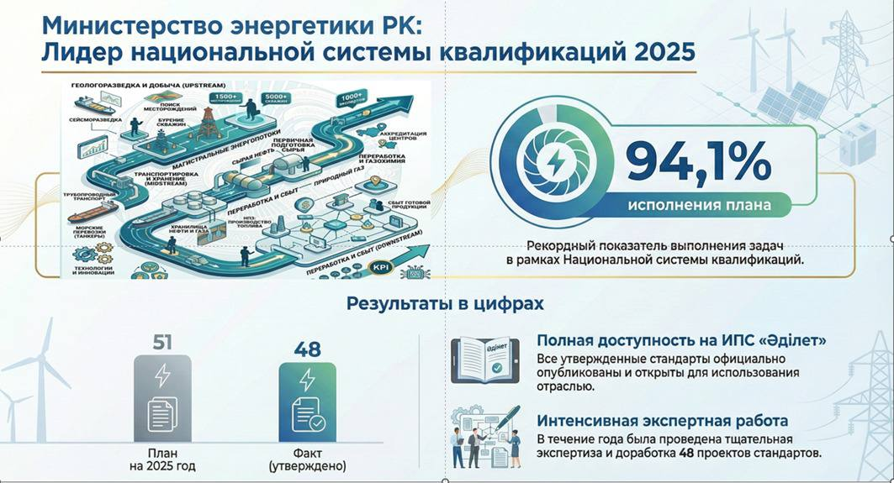
MINISTRY OF ENERGY OF THE REPUBLIC OF KAZAKHSTAN:
LEADER OF THE NATIONAL QUALIFICATIONS SYSTEM 2025
PLAN IMPLEMENTATION RATE
A record level of implementation of objectives within the framework of the National Qualifications System
Results in figures
Full accessibility through the “Adilet” Legal Information System
All approved standards have been officially published and are openly accessible for industry use.
Intensive expert work
During the year, 48 draft standards underwent comprehensive expert review and refinement.
Planned for 2025
Actual (approved)
Slide №5

Slide 7
2023
- Composition of the Sector Skills Council for Professional Qualifications (SSCPQ) — 44 members
- Election of the Chairperson of the SSCPQ (oil and gas sector)
- Submission of the Regulations on the SSCPQ (oil and gas sector) for consideration
- The minutes specify the following subgroups: Upstream, Petrochemicals, Downstream
- Discussion of three Sectoral Qualifications Frameworks (SQFs)
- Another association officially submits an application to join the SSCPQ (oil and gas sector)
- Approval of the Regulations on the SSCPQ (oil and gas sector)
- Approval of three SQFs across three areas
- Approval of 41 Occupational Standards (OSs) across three areas
2024 (Composition of the SSCPQ - 45 members; Working Groups - 61 members)
-The Ministry of Energy of the Republic of Kazakhstan approves the Action Plan for the updating and/or development of Occupational Standards for 2024, with the allocation of responsibilities among the relevant departments of government bodies
-The SSCPQ (oil and gas sector) instructs government bodies to send letters to oil and gas enterprises regarding the establishment of Working Groups (or SSC sector groups) for the development of Sectoral Qualifications Frameworks (SQFs) and Occupational Standards (OSs)
- Approval of the 2024 work plan of the SSCPQ (oil and gas sector)
- All relevant specialized organizations are recommended, when initiating Occupational Standards (OSs) or Sectoral Qualifications Frameworks (SQFs), to propose amendments to the plan and to carry out the development (updating) of OSs and SQFs using their own resources
- The Ministry of Energy has been tasked with organizing training for members of the Working Groups and the SSCPQ throughout the year
ABOUT THE SECTOR SKILLS COUNCIL IN THE ENERGY SECTOR
Слайд №6

Slide 8
2024
-The Ministry of Energy of the Republic of Kazakhstan approves the Action Plan for the updating and/or development of Occupational Standards (OSs) for 2024, with the allocation of responsibilities among the relevant departments of government bodies
- The SSCPQ (oil and gas sector) instructs government bodies to send letters to oil and gas enterprises regarding the establishment of Working Groups (WGs) (or SSC sector groups) for the development of Sectoral Qualifications Frameworks (SQFs) and Occupational Standards (OSs)
- Approval of the 2024 work plan of the SSCPQ (oil and gas sector)
- All relevant specialized organizations are recommended, when initiating Occupational Standards (OSs) or Sectoral Qualifications Frameworks (SQFs), to propose amendments to the plan and to carry out the development (updating) of OSs and SQFs using their own resources
- The Ministry of Energy has been tasked with organizing training for members of the Working Groups (WGs) and the SSCPQ throughout the year
- Three Working Groups of the SSCPQ are established
- The Sectoral Qualifications Framework (SQF) is submitted for approval to the Sectoral Council for Qualifications under the Ministry of Energy of the Republic of Kazakhstan
- A Roadmap for the transition from qualification directories to Occupational Standards (OSs) is discussed
- A proposal is being prepared for assigning National Classification of Occupations (NCO) code 61 to occupational titles
- Representatives of the National Body for Professional Qualifications are invited to all meetings
- Complex correspondence is conducted with the Centre for Labour Resources Development and the Ministry of Labour and Social Protection of the Population of the Republic of Kazakhstan regarding comments on Occupational Standards (OSs), including explanatory remarks and justifications
- Sectoral Qualifications Frameworks (SQFs) are approved with updated data and functional maps of qualifications (FMQs), etc.
- The first attempt is made to conduct a survey among companies on the analysis and assessment of the use of occupations from qualification directories and Occupational Standards (OSs)
- Amendments are introduced to the composition of the SSCPQ
- Occupations from the Atlas of New Professions are reviewed
- Occupational Standards (OSs) are being coordinated
ABOUT THE SECTOR SKILLS COUNCIL IN THE ENERGY SECTOR
Слайд №7

Slide 9
ABOUT THE SECTOR SKILLS COUNCIL IN THE ENERGY SECTOR
2025
-The Ministry of Energy of the Republic of Kazakhstan approves the Action Plan for the updating and/or development of Occupational Standards (OSs) for 2025, with the allocation of responsibilities among the relevant departments of government bodies
- The SSCPQ (oil and gas sector) instructs government bodies to send letters to oil and gas enterprises regarding the establishment of Working Groups (WGs) (or SSC sector groups) for the development of Sectoral Qualifications Frameworks (SQFs) and Occupational Standards (OSs)
- Approval of the 2025 work plan of the SSCPQ (oil and gas sector)
- The Ministry of Energy has been tasked with organizing training for members of the Working Groups (WGs) and the SSCPQ throughout the year
- Seventeen meetings of the Working Groups are conducted across three areas (offline/online)
- The Sectoral Analytical Centre of the Fuel and Energy Complex under the Ministry of Energy of the Republic of Kazakhstan joins the work on the Sectoral Qualifications Frameworks (SQFs)
- A Roadmap for the transition from qualification directories to Occupational Standards (OSs) is discussed
- The Association submits for approval proposals on assigning National Classification of Occupations (NCO) codes to 53 occupational titles
- Representatives of the National Body for Professional Qualifications are invited to all meetings
- A separate section entitled “Principles for Harmonizing Occupational Standards with the Unified Tariff and Qualification Handbook (UTQH), Qualification Handbooks (QHs) and the Technological Qualification Characteristics Handbook (TQCH)” is incorporated into the Sectoral Qualifications Frameworks (SQFs)
Sectoral Qualifications Frameworks (SQFs) are approved with updated data and functional maps of qualifications (FMQs)
Occupational Standards (OSs) are coordinated/approved (16 Occupational Standards and 51 occupation cards)
Approved Occupational Standards (OSs) are published on the Association’s website
2026
-The Ministry of Energy of the Republic of Kazakhstan approves the Action Plan for the updating and/or development of Occupational Standards (OSs) for 2026, with the allocation of responsibilities among the relevant departments of government bodies
-The SSCPQ (oil and gas sector) instructs government bodies to send letters to oil and gas enterprises regarding the establishment of Working Groups (WGs) (or SSC sector groups) for the development of Sectoral Qualifications Frameworks (SQFs) and Occupational Standards (OSs
-Approval of the 2026 work plan of the SSCPQ (oil and gas sector
- One meeting of the Sectoral Council is held in January.
In February, April and May, weekly sessions of the Working Groups are conducted across three areas (offline/online)
The Sectoral Analytical Centre of the Fuel and Energy Complex under the Ministry of Energy of the Republic of Kazakhstan joins the work on the Sectoral Qualifications Frameworks (SQFs)
Representatives of the National Body for Professional Qualifications are invited to all meetings
New requirements for working on the digital platform through the electronic digital signature (EDS) system are introduced
Slide №8

Slide 10
ROLE OF KAZENERGY IN THE SECTORAL COUNCIL
2016–2018 — establishing the institutional foundation
KAZENERGY, jointly with the Ministry of Energy, participated in the development of the first Sectoral Qualifications Frameworks (SQFs) for the oil and gas and energy sectors.
The methodological foundation for the system of Occupational Standards (OSs) was established.
The Association acted as a key sectoral expert representing the interests of employers.
Role: initiator and co-developer of the architecture of the National Qualifications System in the energy sector.
2019–2021 — institutionalisation and expansion of participation
KAZENERGY strengthened its participation in working groups under government bodies.
The practice of involving representatives of the Association in expert and advisory structures was expanded.
Active integration of employers into the process of developing qualification requirements began.
Role: expert and coordination platform between the government and oil and gas companies.
2022–2023 — transition to the systematic development of occupational standards
KAZENERGY performs the function of a social partner representing employers in the development of Occupational Standards (OSs) and Sectoral Qualifications Frameworks (SQFs).
Participation in the development of the regulatory framework and qualification methodologies is strengthened.
The focus shifts towards modernizing the workforce training system in line with labour market needs.
Role: key developer and aggregator of employers’ requirements.
Slide №9

Slide 11
ROLE OF KAZENERGY IN THE SECTORAL COUNCIL
2023–2024 — active operation of the sectoral councils
Representatives of KAZENERGY chair and actively participate in meetings of the sectoral councils under the Ministry of Energy of the Republic of Kazakhstan.
Within the framework of the councils, the following activities are carried out:
  updating Occupational Standards,
  development of Sectoral Qualifications Frameworks,
  coordination of educational programs.
The Association participates in shaping the sector’s human resources policy and in assessing skills shortages.
Role: center of sectoral expertise and coordinator of qualifications policy.
2025-2026 — strategic role in the transformation of the qualifications system
KAZENERGY acts as one of the key drivers of the modernization of Occupational Standards (OSs) in the context of:
  the energy transition,
  digitalization of the sector,
  the development of renewable energy sources (RES) and new technologies.
Its role is being strengthened in the development of:
  functional maps of occupations,
  forecasting models for workforce needs,
  new competencies for the future.
Role: strategic partner of the government in the modernization of the National Qualifications System.
Slide №10

Slide 12
SECTORAL COUNCIL FOR PROFESSIONAL QUALIFICATIONS IN THE OIL AND GAS, OIL REFINING AND PETROCHEMICAL INDUSTRIES
11 карточек профессий и разработаны 11 новые карточки профессий.
    Area
    “Oil and Gas Exploration and Production”
  During the period from january to may 2026:
  1 meeting of the Sectoral Council and 6 Working Group meetings by sector were conducted
  The development and updating - of 21 Professional Standards (PSs) and 62 Qualification Cards (QCs) were discussed (preliminarily), along with an additional review of approximately 150 occupation cards from the National Classification of Occupations of Kazakhstan (NCOC)
  3 Sectoral Qualifications Frameworks (SQFs) are currently being updated (in accordance with the National Qualifications Framework of the Republic of Kazakhstan for 2025)
  Participation in training on the operation of the digital platform of the National Qualifications Authority under the new requirements involving the use of Electronic Digital Signatures (EDS) and Artificial Intelligence (AI) was undertaken
8
21
professional standards
occupations
    Area
    “Transportation and Storage of Oil and Gas”
7
8
professional standards
occupations
    Area
    “Oil and Gas Processing and Marketing”
6
33
professional standards
occupations
Slide №11

Slide 13
THE ROLE OF SECTORAL COUNCILS FOR PROFESSIONAL QUALIFICATIONS IN KAZAKHSTAN
Further improvement of the organizational and methodological support for the activities of Sectoral Councils is required
Enhancing the alignment and consistency of approaches
Strengthening the coordination role of the authorized state body
Development of the analytical framework and evidence base
Systematic efforts to enhance the competencies and engagement of participants, which should ensure more sustainable and effective functioning of the Sectoral Councils within the framework of the National Qualifications System.
Слайд №12

Slide 14
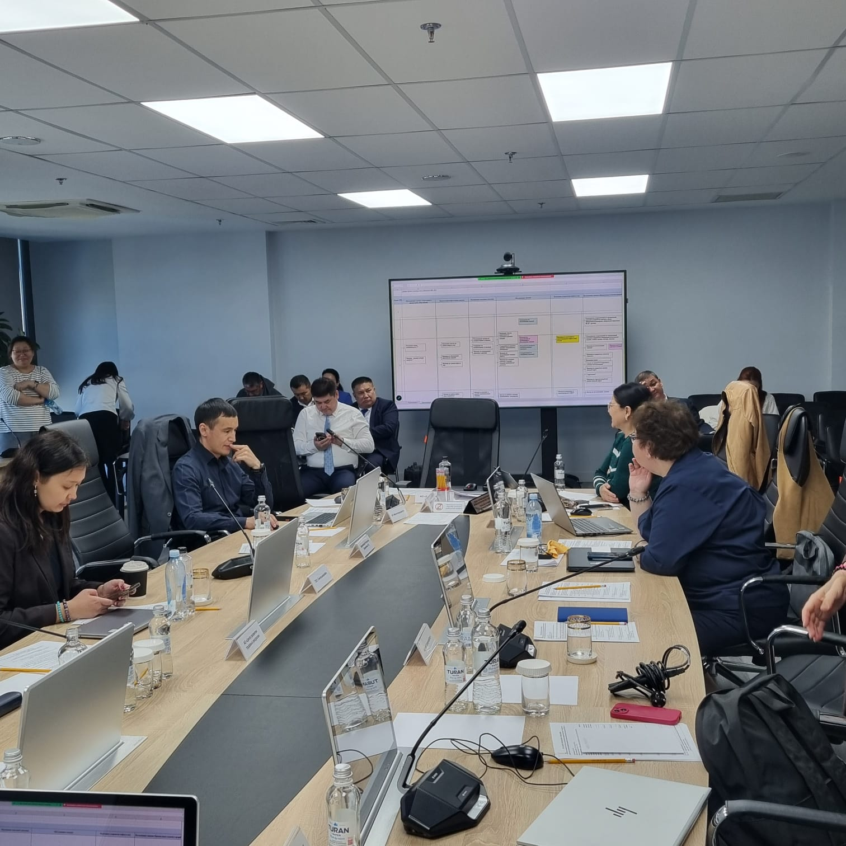
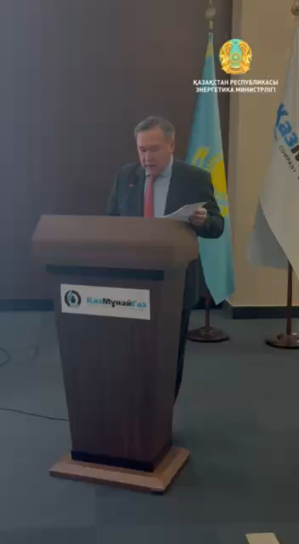
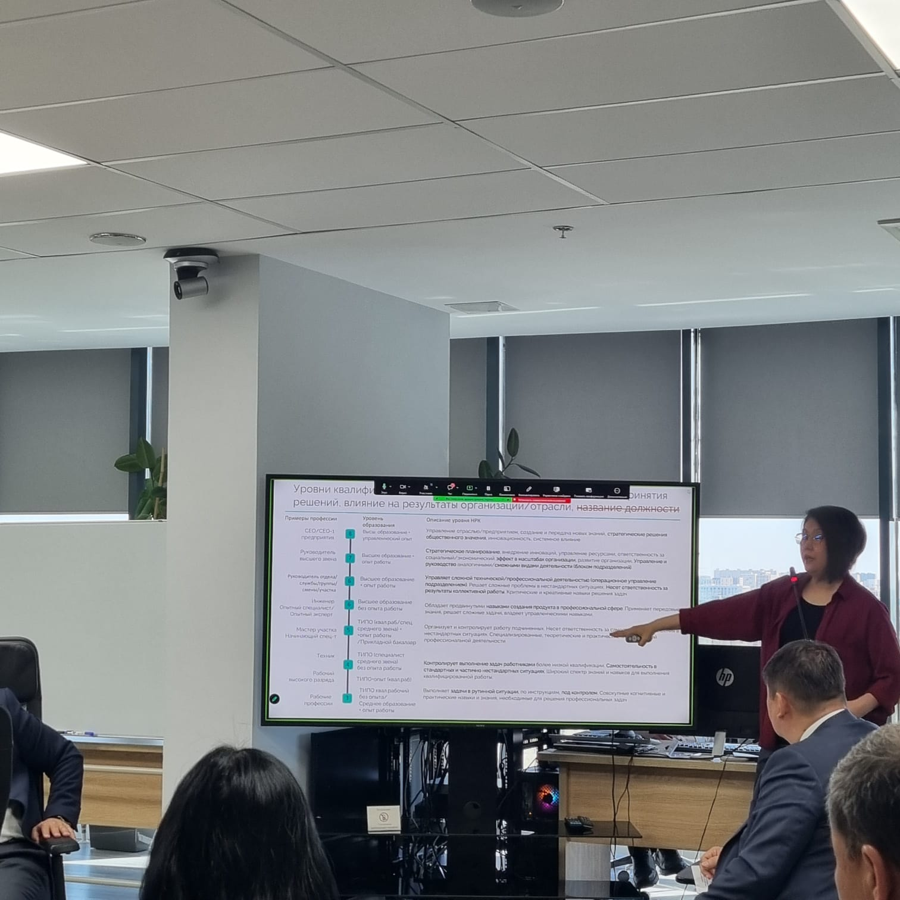
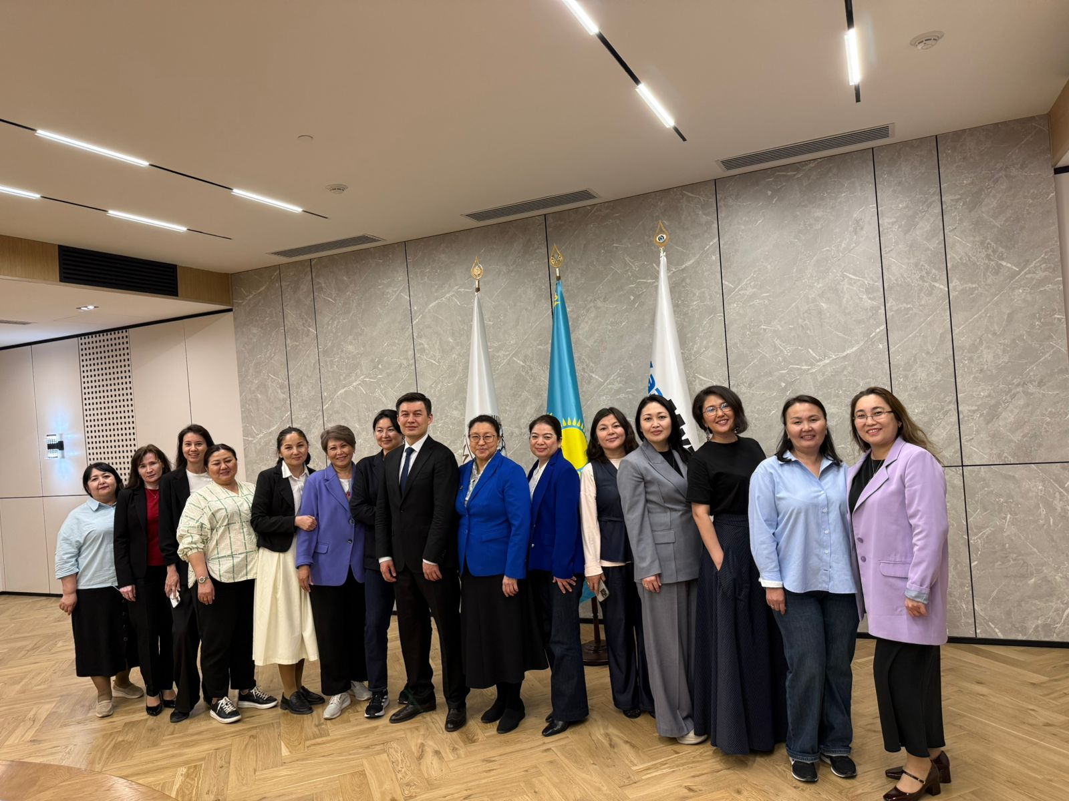
https://t.me/Minenergokz/8531

Slide 15
Thank you for attention!

