Slide 1

Monitoring of ALMPs
Joel Pousette, Analyst

Slide 2
Generell information about Arbetsförmedlingen (Swedish PES) and the Department of Analysis

Slide 3
Arbetsförmedlingen – The Swedish Public Employment Services
Aprox. 11 000 employees and 100 local offices around the country
PES Sweden is divided into six regions. Headquarter is located in Stockholm.
The main mission of the Swedish PES is to:
Effectively bring together job seekers with employers who are looking for labor
work to shorten unemployment periods for job seekers and vacancy periods for employers
provide support and measures when justified to strengthen a job seeker’s chances of obtaining employment
through employment-promoting measures encourage employers to hire job seekers who cannot obtain work without support.

Slide 4

The Departement of Analysis at the Swedish PES
The Swedish PES is committed to ensure that its support for job seekers is guided by evidence and best practices. This is a key responsibility of the Department of Analysis.
We are around 60 people, including many with PhDs in economics and statistics, alongside colleagues with strong expertise in qualitative research.
The unit both conducts randomized studies in order to give insight into what kind of ALMPs are efficient, and monitors the overall goals established by the Swedish PES.

Slide 5
What are effective ALMP for vulnerable groups and youth in the Swedish context?

Slide 6
What are effective ALMP
Based on evaluations conducted both by our unit and by other institutions, we find solid evidence that these programmes generally have positive effects on vulnerable groups :
Vocational training
Intensive job coaching
Subsidized employment

Slide 7
What programmes do we have for youth?
Apart from the programmes mentioned in the last slide we have three programmes especially constructed with the purpose of meeting the needs of the youth.
UGA – a programme that youth enters after 3 months of unemployment
Samstart – a collaboration with the schools and the Swedish PES
Study-motivating course at folk high school for people lacking secondary education

Slide 8
From evidence to planning and monitoring

Slide 9
The Results Chain – a model for planning and monitoring
Prerequisites Important factors that influence our ability to achieve results.
“Making the right things happen” by identifying how we can best create results. Goals and indicators are set for the most important outcomes and outputs. Planning and follow-up should connect actions with objectives.
Activities
Outputs
Outcomes
Long-term effects
Outlines the activities we carry out within the organization to achieve results, including processes, continuous improvement, and production.
Describes the internal outcomes of our operations, often in the form of volumes and flows. Should clearly contribute to the results.
Describes the external change generated by our activities and outputs. It arises through the interaction between the organization, the surrounding environment, and customers, and should clearly contribute to the overall objectives.
Describes developments in the labor market and the societal value that the organization is expected to contribute to.

Slide 10
Summary – assessment of goal achievement
Target | Assessment
Outcome target
Prevent an increase in long-term unemployment among women and men | On track
Maintain a high proportion of job-seeking women and men with disabilities who enter employment or education | On track
Increase the share of women and men who begin studies | Significantly below plan
Output target
Increase the number of people in subsidized employment | Significantly below plan
Maintain the current level of participation (job seekers) in vocational training | Slightly below plan
Maintain the current level of participation (job seekers) at the private recruitment company | Significantly below plan
Increase gender equality and equity in our use of interventions | Significantly below plan
Increase the number of people who apply for regular education | Data not available
Strengthen support for jobseekers who are furthest from the labor market | On track
Ensure that the monitoring of jobseekers enables improved matching, particularly for those furthest from the labor market | On track
Increase the quality of case management and reduce incorrect payments | Slightly below plan

Slide 11
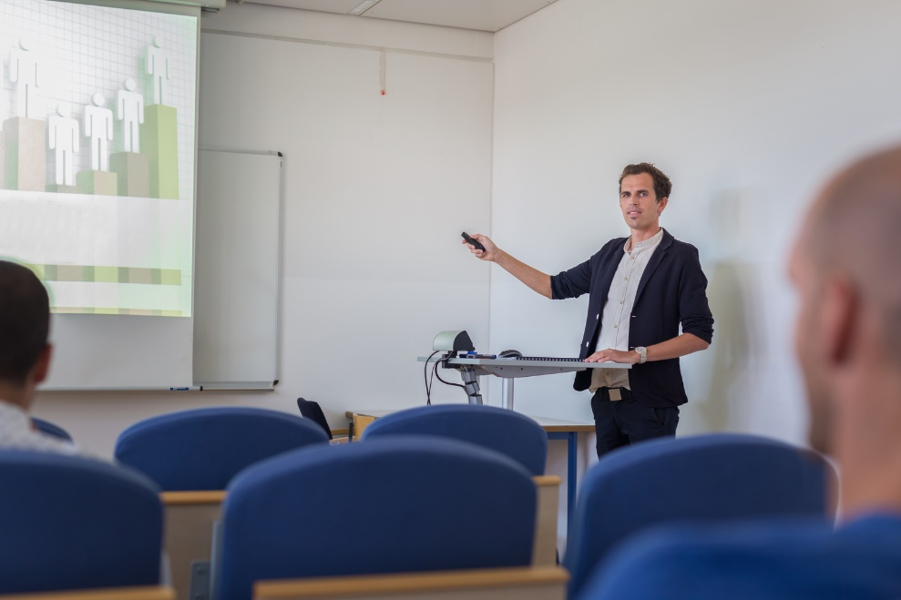
Monitoring the operational plan
Monthly and tertial monitoring
Annual report
Forecast for payment

Slide 12
Challenges in analyzing the results
We manage and measure things that the organization has limited ability to fully influence or control.
At times, it is difficult to measure whether the PES has carried out activities for the jobseeker that actually brought them closer to employment (progression). This is particularly challenging in cases where individuals do not find work after an intervention.
We often struggle to determine what constitutes the PES contribution. What is due to the economy? Changed behaviors? Have other conditions shifted? It is difficult to create “pure” outcome and output indicators. Outcomes are often (almost always) affected by factors outside the PES. This applies partly to output indicators as well.
Sometimes it is difficult to determine when the organization has done a “good” job. Unemployment will never be zero.

Slide 13

Data sources used to support the approach
All job seekers are registered in our data system.
Extensive information about each jobseekers.
In some randomized studies we use other data bases for example from the Swedish tax office

Slide 14
Case: From randomized study on contracting out employment services to management impact
One of the most extensive randomised study ever conducted
Showed small or no positive results for vulnerable groups including youth
Resultated in numerous activities in the operational plan with the purpose of improving the program:
removing the private private providers with the poorest results and
changing the payment model with more focus on an outcome based model and job duration
Notes:
the data we use to monitor our goals and indicators are based on our own data base system. All job seekers are registered there and the we have extensive information about each jobseekers. For the monitoring of the operational plan we have develop an dynamic desktop in the programme Qlicksense where we can monitor the goals and indicators.

Slide 15
Thank you!

