Slide 1
Work-Based learning for Youth in Austria
International Conference on Youth Employment and Skills Development: Partner Dialogue for effective School-to-Work-Transition in the year of Working Professions 2025
Astana – Kazakhstan, 24.9.2025

Slide 2
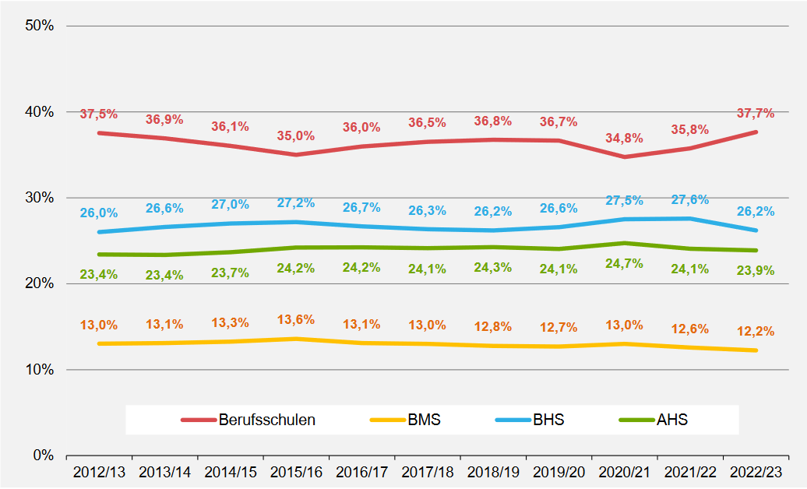
Pupils by 10th schoolgrade (≈16 years)
38% of each cohort take up an apprenticeship within the dual system (Vocational Training)
Most common qualification in Austria (1/3 of the population)
Outstanding relevance for economy and skilled workers
Apprenticeship
Interm. Vocational School
Higher Vocational School
Academic School

Slide 3



Apprenticeship – Vocational Education and Training
Training Company
Vocational School
Qualification Certificate
80% of training period
Vocational school [theoratical education]
20% of training period
Scholar Curriculum
Theory and general education
Completes practical training in the workplace
Option for extended learning period (+1year)
Apprentice income
Duration:
2-4 years
(200 professions)
Contract with company
Practice
Technical-, work- and social skills
Skilled worker after final examination
Detailed training regulations / curriculum

Slide 4
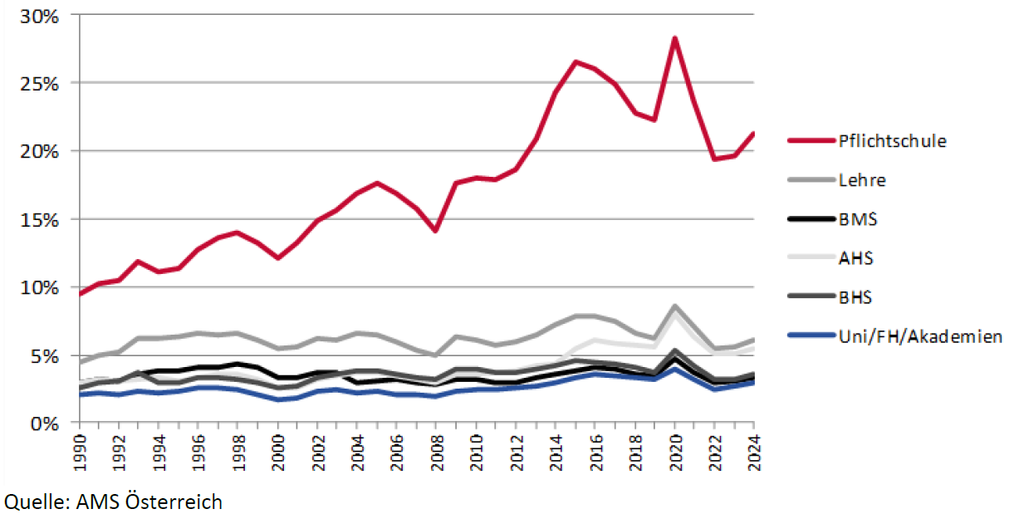
Uneployment rate by highest education
Compulsory School
Apprenticeship – Vocational Training
Intermediate Voactional School
Academic school
Higher Voactional School
High School / University

Slide 5

Supra Company Apprenticeship (Public Employment Service)
Educational Training Institution
Vocational School
Qualification Certificate
Contract with PES
Vocational school [theoratical education]
20% of Training time
Scholar Curriculum
Theory and general education
Completes practical training in the workplace
Option for extended learning period (+1year)
Psychosocial support (individual and group)
Pedagogical support and Learning assistance
Placement in company apprentice-ships
Practice – professional trainers
Skilled worker after final examination
Placement of internships in companies

Slide 6
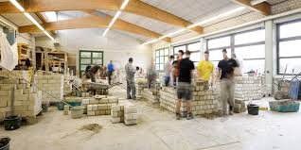
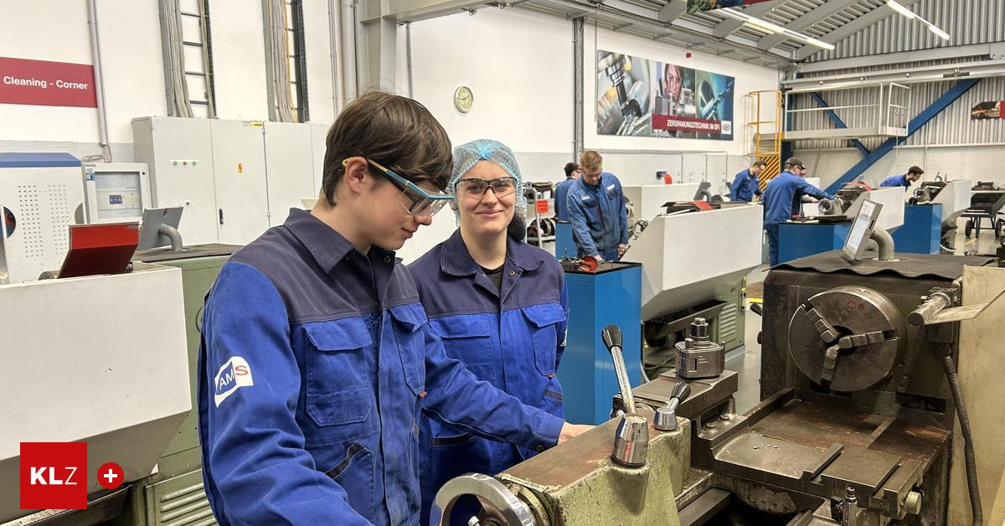

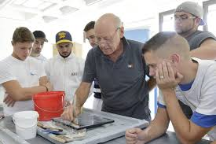
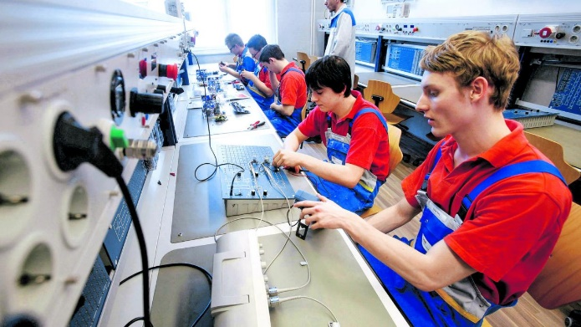
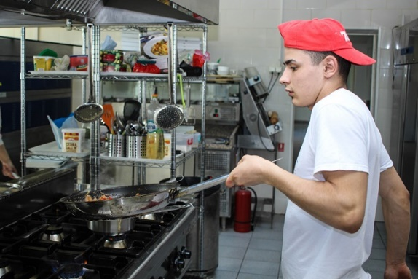
Impressions link to video

Slide 7
Success-rate Supra Company Training

Slide 8

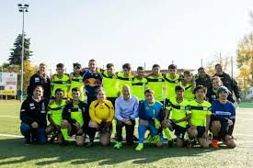
Preparational Labour Market-Projects
Characteristics
Open space / easy accsess
Activities that appeal to young people (sports, hands-on-activities, creation)
„doing something meaningful without pressure“
Multi-professional staff for support
Professional Coaching and educational counseling
Earning small amounts of money

Slide 9
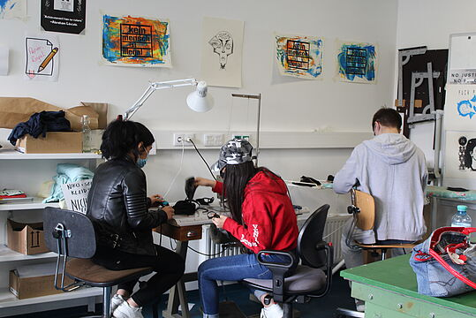
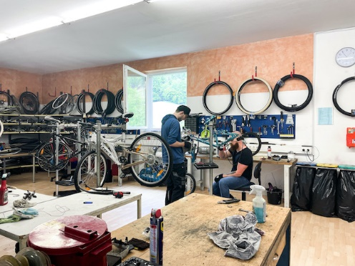
Preparational Labour Market-Projects
Targets
Increase in commitment over time
Providing daily structure and social connection
Acquisition of social skills – practical approach
Vocational (re)orientation
First work experience
Placement in other projects, training
or employment

Slide 10
Preparation and Introduction
Orientation and Guidance
Qualification and Palcement
Stabilization and Support
High-threshold
Supra-company training
Fit for Training
Youth Coaching
Preparational projects
Low-threshold

Slide 11
Employer Engagement Strategies
Professional business contacts and consulting in
        apprenticeship offices of the Austrian Federal Economic Chamber,
        Public Employment Service for companies,
        business service for people with disabilities,
        youth programmes
        Strong financial incentives: Labour market policy support instruments for training companies
        Good networks, importance of apprenticeships for Austrian economy widely recognised,
        yet shortage of apprentices

Slide 12
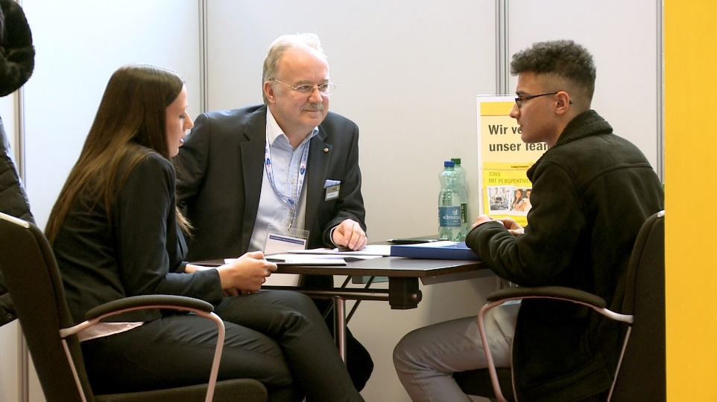
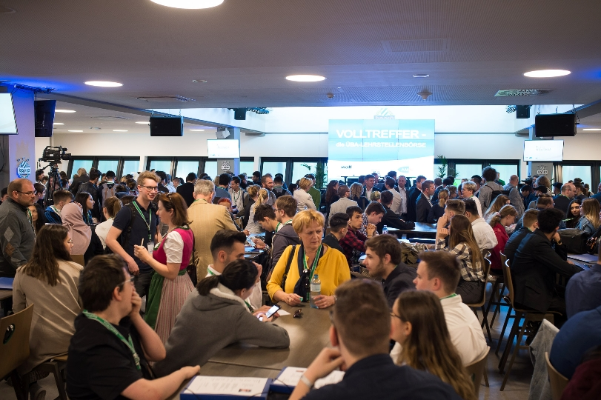
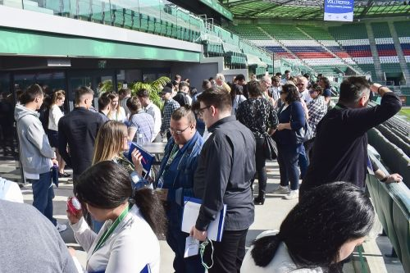
Impressions
- link to video

Slide 13
Challenges for (Supra) Company Training
Many young people with psychosocial problems
Frequent lack of language skills (mainly in Vienna)
Mobility issues in rural areas
Discussion on quality of company training
General matching problems on the labour market
Work-based Learning

Slide 14
Thanks for your attention!
Kai Hartig
Federal Ministry Labour, Social Affairs, Health, Care and Consumer Protection
Unit – Integration of adolescents and young adults into education and labour market
kai.hartig@sozialministerium.gv.at

