Slide 1

Policy approaches for supporting youth transitions The case of EU Youth Guarantee
Astana, 24 September 2025; Cristina Mereuta, ETF

Slide 2
THE YOUTH GUARANTEE
What is the Youth Guarantee?
An EU initiative ensuring that all young people under 30 receive a good-quality offer of: employment, continued education, apprenticeship or traineeship within 4 months of becoming unemployed or leaving education.
Why it matters
Tackling youth joblessness is essential for economic stability, social inclusion, and the long-term resilience of labour markets.
The ETF’s Role
Policy advice: Supporting neighbouring countries to design youth employment strategies aligned with the Youth Guarantee principles
Capacity building: Working with ministries, employment services, and training providers to improve outreach, delivery, and monitoring
Peer learning: Facilitating exchanges between EU and partner countries to share successful practices and models
Monitoring and analysis: Generating evidence on youth transition, skills gaps, and policy impact to inform national reforms
Notes:
Slide 21
HOW ETF delivers impact now and what can it further do?
How ETFs work ensures impact is our biggest driver. Over the years, we have seen in our partner countries studies remaining on ministerial shelves, we have seen policies and strategies not implemented, we have seen structures developed without sustainable foundations, we have seen processes that have didn’t allow space for calibration, we have seen decisions taken without consultations with social partners and stakeholders. For us, it is clear that is not only what you know but how you create conditions to implement what you know.
ETF though a European agency, is seen by our partners as a neutral broker. This unique feature makes ETF a pivotal partner in Team Europe approach. We are well recognised as a knowledge hub and well trusted for our knowledge and ability to contextualise our expertise to provide policy advice. This trust forges partnerships with international organisations and international financial institutions but also member states. We are increasingly seen as a connector of different partners.
This is where we believe our added value is most impactful. This is where we feel that our history better serve our future.
To discuss this aspiration further we have developed some questions for your input.
Stronger presence in the countries in a systematised way?​
How do we work more closely and in a structured way with: ​
EU Delegations and EU agencies​
EU Member States and development agencies ​
IFIs and other international organisations?​
Sectoral policy priorities? ​
EU Accession?​

Slide 3
YOUTH GUARANTEE: PATTERNS IMPACTING NEET PROFILE AND POLICIES
Out of workforce and poverty. Fragility and resilience
Mismatches and
under skilled
Persistent gender gaps esp. age group 25-29; lower propensity for job search among young women
Improved retention and progress in initial education but insufficient relevance of skills
Limited opportunities for further training including second chance education and flexible learning pathways
Tap in digital and entrepreneurial skills of young generation and match their expectations (e.g. support service design and delivery)

Slide 4

YOUTH GUARANTEE CHALLENGES
Early interventions, quality education, career counselling and work-based learning opportunities
Mapping and YG registration of young people in rural and remote areas and/or belonging to vulnerable communities
Cooperation among YG actors including education, training and employment providers, including data protection
Role and capacities of social partners, youth organisations, specialised NGOs
Underdeveloped outreaching and support services as well as integrated YG services
Providing equal access and opportunities to young unemployed, inactive and vulnerable NEETs
Securing human and financial resources (employment, education, training and social service providers)

Slide 5
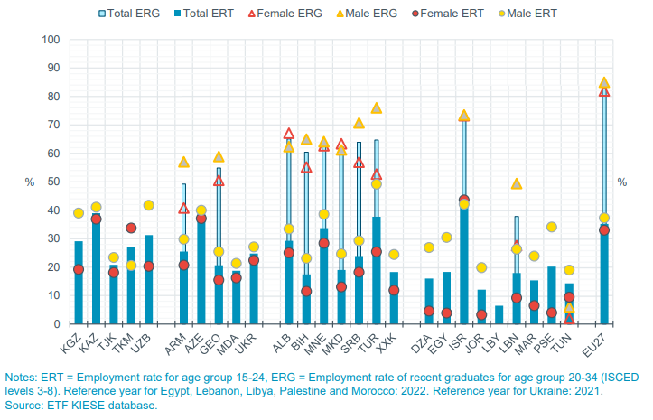
YOUTH TRANSITION
Employment rate of recent graduates (ERG), aged 20-34, and employment rate of youth (ERT), aged 15-24, 2023
caregiving responsibilities and societal norms re employment
limited access to jobs (matching studies and career aspirations)
variation in NEETs across main educational tiers reflects structural barriers and effectiveness of education systems in facilitating youth transition to work and continued learning
Education, skills and employment: Trends and developments 2024 | ETF

Slide 6
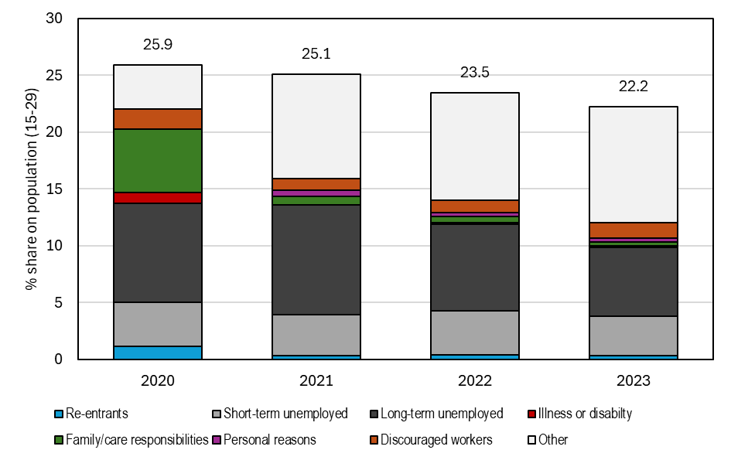
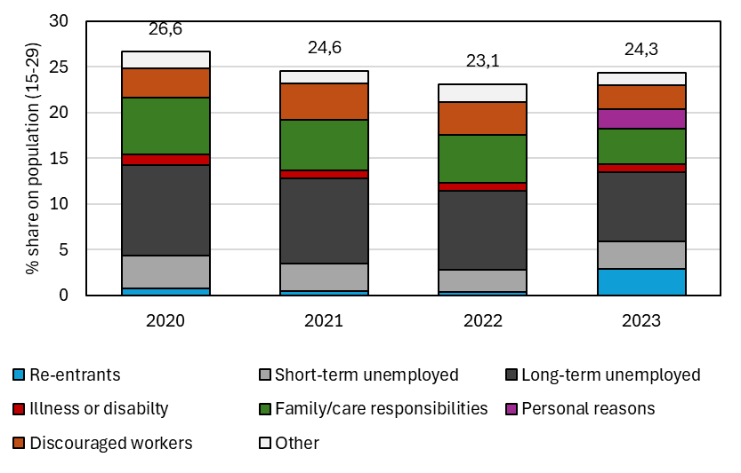
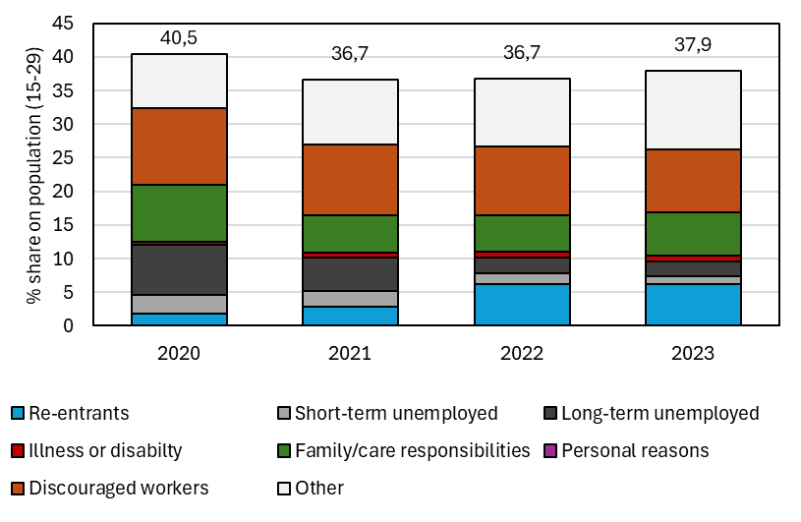
NEET PROFILE
Bosnia and Herzegovina
Serbia
North Macedonia
Kosovo

Slide 7
YG AND INTEGRATED POLICIES FOR NEET IN ETF PARTNER COUNTRIES
WESTERN BALKANS | EASTERN PARTNERSHIP | SEMED | CENTRAL ASIA
YG Implementation Plans (advice, capacity building, review and suggestions). Pilots ongoing in several municipalities in each country. Relevant commitments Growth Plan/Reform Agenda Knowledge sharing and YG coordinators meetings EU IPA regional project on YG plus country IPA – ETF invited to contribute as per specific areas of expertise Country policy advice actions to keep reform momentum | EU4Youth regional programme (regional experience sharing; piloting in few countries). ETF input to EU4Youth Experience exchange / peer leaning including in North Macedonia Ukraine set up YG Interagency Working Group mid 2024 ➔ ETF comprehensive learning and support programme to support capacity development and preparation for YG. | Launched EU supported Youth-NEET regional project Ttraining and peer exchange events with focus on career guidance and counselling, skills development, skills mismatches and work-based learning UfM Community of Practice on Youth Employment | YG specific information/ raise awareness sessions Youth transition activities in EU funded DARYA programme implemented by the ETF Policy learning event September 2025
Activities supporting ETF input to YG: Evidence: KIESE, mismatch/NEET profile, specific surveys and research, including with UNICEF and Eurofound Knowledge and policy advice focus: skills dimension of ALMP/PES, WBL mappings, career counselling, outreaching, governance, qualifications/validation Global opportunities to promote EU Youth Guarantee – Thailand progress towards NEET integrated policy approaches

