Slide 1
Entrepreneurial Centres of Vocational Excellence:
a boost for economies and societies
DARYA meeting, May 21, 2025
Mariavittoria Garlappi
Senior HCD expert

Slide 2
Rationale for EntreCoVEs
1
2
3
Developing Entrepreneurial Spirit: more relevance and efficiency
CoVEs Effectively support socio-economic development
CoVEs help citizens’ employability: employees, self-employed, entrepreneurs
Notes:
Why was this Toolkit Created? The toolkit was created to support Centres of Vocational Excellence (CoVEs) to become more entrepreneurial, create a robust Ecosystem Engagement Tool to enhance CoVEs’ ability to connect and collaborate with diverse stakeholders and identify potential partners, prioritize collaborative value and foster long-lasting relationships

Slide 3
Three main tools
1
2
3
Conceptual framework
Self-assessment toolkit
Ecosystem engagement toolkit
Notes:
Why was this Toolkit Created? The toolkit was created to support Centres of Vocational Excellence (CoVEs) to become more entrepreneurial, create a robust Ecosystem Engagement Tool to enhance CoVEs’ ability to connect and collaborate with diverse stakeholders and identify potential partners, prioritize collaborative value and foster long-lasting relationships

Slide 4
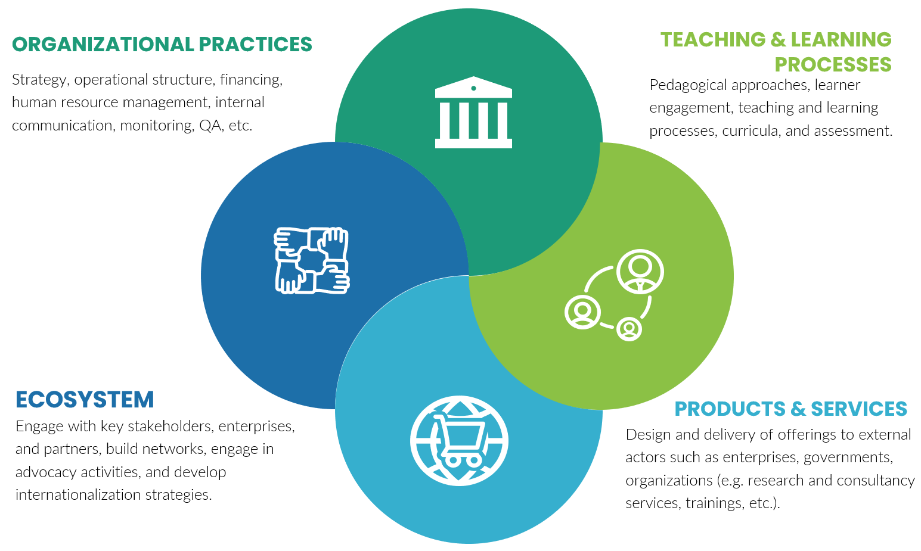
Entrepreneurial CoVE Conceptual Framework
Digital technology in education - Lessons learnt from Covid Emergency

Slide 5
Conceptual Framework (Cont.)
Digital technology in education - Lessons learnt from Covid Emergency
Organisational practices
A well-defined strategy
Ecosystem
Entrepreneurial vision in collaboration with key stakeholders
Teaching and learning processes
Real-world, collaborative, project-based Learning
Products and services
Leadership support
Staff Recognition and rewards
Internal monitoring and communication
Digital strategy
Diverse finance mechanisms and revenue generation
Strong network with private and public stakeholders
Collaboration with enterprises for work-based learning
Strong external communication of entrepreneurial vision and actions
Community engagement
Dynamic collaboration with innovation and science actors
Opportunities for entrepreneurial practice
Staff training on entrepreneurship skills
Evaluation of staff integration of entrepreneurship skills
Addressing sustainable development goals (SDGs)
Career guidance and advice
Skills development and training
Collaboration on applied research
Plan and financing for business incubators and start-ups
Technology transfer and innovation consulting

Slide 6
The Self-assessment Tool
Digital technology in education - Lessons learnt from Covid Emergency
Step 1. Team formation
Key stakeholders must be engaged in the process. Each CoVE should establish an internal team that will be engaged in the project. Members of this team can include representatives from the following groups:
Management team;
Teaching staff;
Learners;
Administrative staff.
Step 2. Meeting to discuss and complete the reflection tool
Before the meeting, the team members must have access to key documents that need to be reviewed to facilitate the discussions and areas of improvement.
Step 3. Sharing with stakeholders in the ecosystem – Optional
Bilateral/multilateral exchanges can be planned to discuss the reflection and finalise the areas of improvement with key stakeholders in the ecosystem. The aim is to help CoVEs see their state/progress through the eyes of their main partners.
APRÈS L'URGENCE - VERS UNE DTL SYSTÉMIQUE DANS L'ÉDUCATION

Slide 7
The Self-assessment Tool
Digital technology in education - Lessons learnt from Covid Emergency
Organisational Practices | Teaching and Learning Processes
There is a strategy where entrepreneurial objectives and activities are clearly defined. | The EntreComp competencies are integrated across the curricula.
The leadership team is supportive of innovation and entrepreneurial activity. | Teaching and learning are based on real-world, collaborative, project-based, and authentic learning.
Staff are recognised and rewarded for their entrepreneurial competences, activities, and excellence in teaching and service. | Entrepreneurial activities and actions are encouraged that address the Sustainable Development Goals.
There is strong internal monitoring and communication of entrepreneurial vision and actions. | Provides opportunities to learners to practice their entrepreneurial competences (e.g., applied projects, entrepreneurship competitions, etc).
There is a digital strategy linked to entrepreneurial activities and vision. | Career guidance and advice is offered to address entrepreneurial activities.
The CoVE is entrepreneurial in generating revenue from the diversity of sources
APRÈS L'URGENCE - VERS UNE DTL SYSTÉMIQUE DANS L'ÉDUCATION

Slide 8
The Self-assessment Tool
Digital technology in education - Lessons learnt from Covid Emergency
Products and Services | Relationship with the Ecosystem
Collaboration with enterprises and other stakeholders for applied research projects which are linked directly or indirectly with entrepreneurial aspects. | The CoVE implements its entrepreneurial vision in close collaboration with key stakeholders.
Innovative services and products are designed and offered to serve the market needs. | The CoVE has a strong network with key private and public stakeholders and participates in ecosystem entrepreneurial events and activities.
There is a plan and financing mechanism for business incubators and support of start-ups. | The CoVE collaborates with enterprises for engaging in internships, trainee placements, and Work-based learning (WBL) activities.
The CoVE offers technology transfer and innovation consulting services in line with its entrepreneurial vision. | There is strong external communication of entrepreneurial vision and actions.
Research and development are linked with the entrepreneurial vision and fit into the overall products and services offered by the CoVE.
APRÈS L'URGENCE - VERS UNE DTL SYSTÉMIQUE DANS L'ÉDUCATION

Slide 9
The Ecosystem engagement toolkit
WHY?
Shift from Inward Focus
Develop Strategic Partnerships
Promote an Entrepreneurial Mindset
Notes:
VET institutions often lack strategic guidance in stakeholder engagement, leading to ad-hoc, transactional collaborations that underutilize the potential of these relationships. This toolkit addresses this gap by providing a structured approach to: Shift from Inward Focus: Facilitating a change from primarily addressing the institution's needs to proactively identifying and addressing shared interests with stakeholders. Develop Strategic Partnerships: Guiding VET institutions in building robust, long-term collaborations that foster innovation, resource access, and enhanced capacity and Promote an Entrepreneurial Mindset: Encouraging proactivity, innovation, and value co-creation to optimize stakeholder relationships and overcome traditional boundaries.

Slide 10
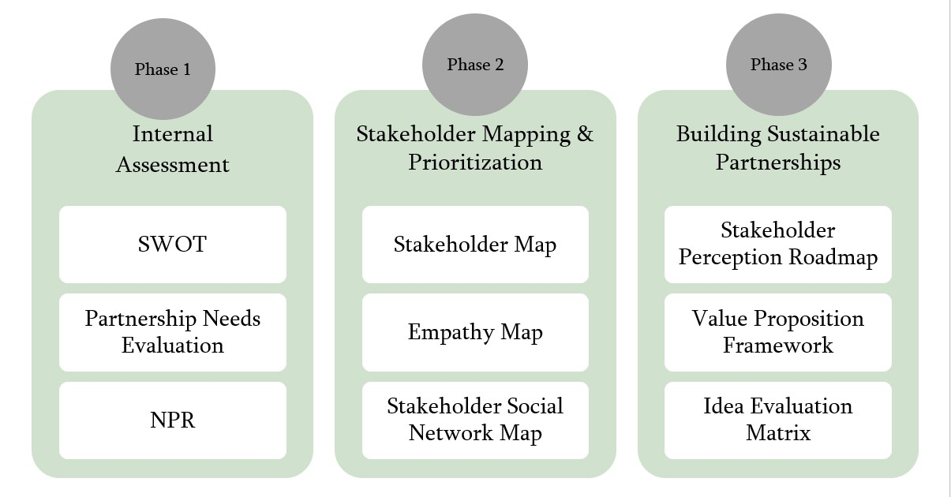
The Ecosystem engagement toolkit
WHY?
Shift from Inward Focus
Develop Strategic Partnerships
Promote an Entrepreneurial Mindset
Notes:
VET institutions often lack strategic guidance in stakeholder engagement, leading to ad-hoc, transactional collaborations that underutilize the potential of these relationships. This toolkit addresses this gap by providing a structured approach to: Shift from Inward Focus: Facilitating a change from primarily addressing the institution's needs to proactively identifying and addressing shared interests with stakeholders. Develop Strategic Partnerships: Guiding VET institutions in building robust, long-term collaborations that foster innovation, resource access, and enhanced capacity and Promote an Entrepreneurial Mindset: Encouraging proactivity, innovation, and value co-creation to optimize stakeholder relationships and overcome traditional boundaries.

Slide 11
Want to know more ?
Entrepreneurial centres of vocational excellence | ETF
Conceptual framework of entrepreneurial centres of vocational excellence | ETF in EN, FR and RU
Skills ecosystem engagement toolkit | ETF in EN
ETF entrepreneurial CoVEs in EN

