Slide 1
Slovak Qualifications Framework – SKKR/SKQF quality assurance of qualifications
DARYA project
Online familiarisation event – Enhancing trust in qualifications
24 May 2023
Ildikó Pathóová, LLL Department

Slide 2
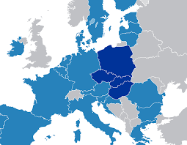
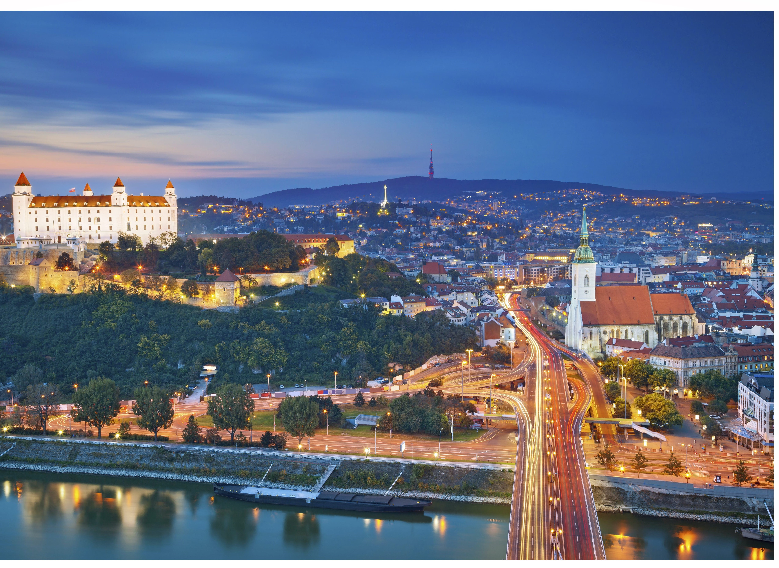
Visegrad Group V4 – since 1991
an informal grouping of four Central European states (Poland, Czech Republic, Slovakia, Hungary)
the same values, a common history, culture and geographic location
The Slovak Republic (1/1/1993–present)
Member of EU on 1 May 2004;
Euro as a national currency since 1/1/2009

Slide 3
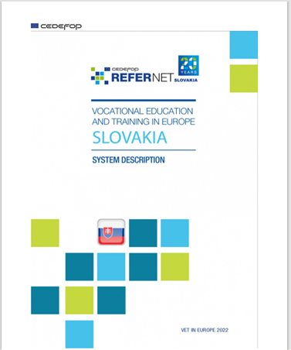
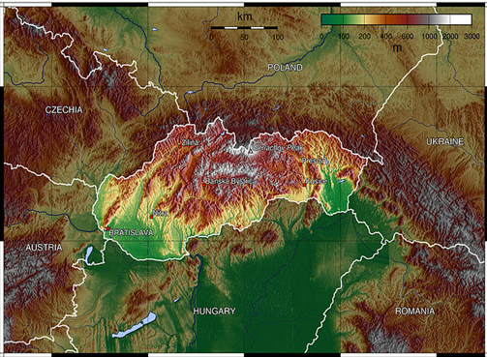
https://www.cedefop.europa.eu/en/print/pdf/node/146076
Area: 49,035 km² Population: 5,460,185 (2022 census)
Main economic sectors:
manufacturing; wholesale and retail trade; repair of motor vehicles; construction; health and social work activities; transportation and storage.
Slovak economy is among the most open in the EU, exporting industry products, mostly automotive;
a world leader in manufacturing of cars per capita

Slide 4
SKKR development - phases
2009
Government Resolution No. 105/2009: tasks and responsibilities of subjects:
2009-2011
National Coordination point for EQF (NCP EQF)
First version of NQF – SKKR (8 levels)
2012-2015
SKKR forms a part of the National Reform Programme
a) To establish an inter-ministerial working group
b) To develop the National Qualifications Framework
c) To harmonise graduate profiles with qualifications standards
d) To identify levels of qualifications on diplomas and certificates
e) To submit a report on NQF implementation to government/EC
2017
Referencing report of the SKKR to EQF: https://europa.eu/europass/en/eqf-referencing-reports
Development of the National Qualifications Register ( 2013-15)
Analyses; methodology for the development of the NQF
Revised SKKR (2014)
Methodology for linking qualifications to SKKR levels
Involvement of stakeholders (employers, experts, institutions, Sector Councils) on SKKR
Adoption of the Government SR

Slide 5
Reforms/changes in education system
2008
Curricular reform – School Act (245/2008): shift to learning outcomes approach
2013-2015
National Qualifications Register:
2015
Elements of dual VET
2018-2019
Criteria for accreditation of study programs of HE
Performance standards
Quality assurance
Two level model of curricula
Qualifications standards
Sector Councils/ employers involvement
Involvement of employers and professional organizations in VET (content, quality assurance, financing) – Act 61/2015 on VET
Decree of the education ministry on the credit system (614/2002)
The Slovak Accreditation Agency for Higher Education – Act No. 269/2018 Coll. (the Qquality Act): https://saavs.sk/en/agency/
Levels of qualifications on diplomas/ certificates

Slide 6
Goals and aims of SKKR
communication tool: to comprehensively inform on accessible qualifications;
transformation tool: to gradually review and change the system of qualifications´ recognition and validation;
regulation tool: to monitor the processes of identification and description of qualifications, their levelling, to regulate the system of qualifications´ recognition and validation as well as the institutions authorised to validation, implementation of quality management.
Furthermore: it provides classification of qualifications; hierarchical levels by a certain level of difficulty; reference characteristics - national descriptors
General consensus:
SKKR is aimed at the enhancement of LLL (accreditation of the curricula for further education is grounded on particular qualifications)
NO distinction between qualifications
from formal education and NFIL

Slide 7
SKKR and its sub-frameworks

Slide 8
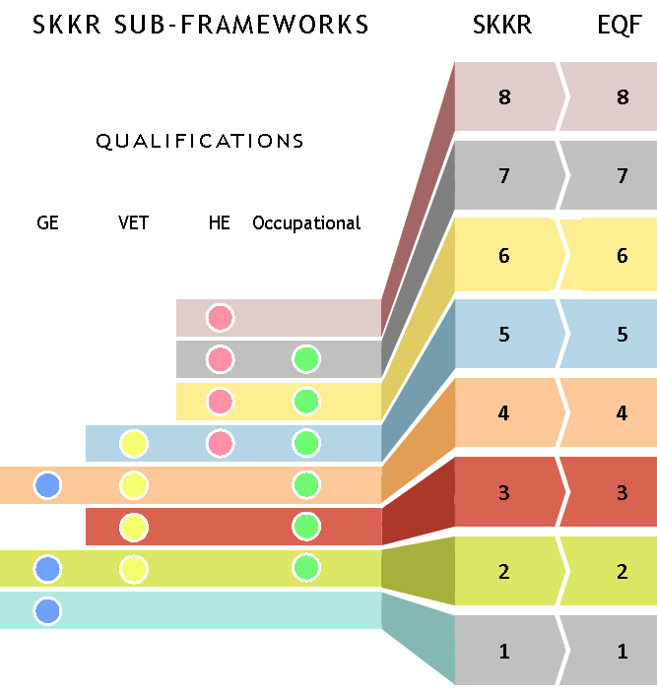
Sub- frameworks ➔ SKKR ➔ EQF
Link between IVET & occupational qualifications
Occupational qualifications – formal VET programmes
Recognition of modules possible
ECVET not yet introduced into the system
SKKR & QF EHEA / self-referencing report / later stage

Slide 9
Transparency Cycle of development, approval and levelling of qualifications

Slide 10
Quality Assurance – criterion 5 of EQF RR
Quality assurance at all levels of the SVK education system / in all legislative norms + EQAVET Recommendation
Assessment of the quality is carried out by:
School or school facility (self-evaluation)
Municipality at the regional level
State School Inspectorate (in specific cases + Ministry of Health)
+ NICME – assessment of acquired LOs (national & international)
+ Government Council for VET

Slide 11
Quality Assurance – External Assessments
National Institute for Certified Educational Measurement – assessment of the level of acquired LOs (Testovanie 5, Testovanie 9, external part of Matura) as well as international measurements (PIRLS, TIMSS, PISA, TALIS, ICILS, etc.)
Independent assessment: INEKO, ARRA, ISO
Regular checking:
Each body must present the report on activities
Governmental Council for VET – monitoring, recommendations
OECD: Survey of Adult Skills (PIAAC - Programme for the International Assessment of Adult Competencies) - assessment and analysis of adult skills: https://www.oecd.org/skills/piaac/

Slide 12
Quality Assurance – further education / adult learning
Accreditation commission for further education:
- quality assurance of programs
- compliance with the qualifications and assessment standards
-on-site checks and controlling mechanisms
http://isdv.iedu.sk/Default.aspx - processes of VNFIL
http://isdv.iedu.sk/Documents/Zakon_568_2009.pdf –suggestions for revision of certain acts related to embedding the SKKR in national quality assurance system

Slide 13
The new system for validation of results of NFIL and its quality assurance processes - EQAVET system peer review

Slide 14
EQAVET principles
Institutional elements of the new system of validation:
national guarantor (NG)
authorised person (AP)
authorised institution (AI)

Slide 15
The new system for validation of results of NFIL

Slide 16
Thank you for your attention!
ildiko.pathoova@minedu.sk
www.minedu.sk

