Slide 1
Social Inclusion
Teacher Training, Practice

Slide 2
LEONARD CHESHIRE DISABILITY ZIMBABWE’S PROFILE
Vision/Goal: LCDZ envisions a society in which every child and youth with a disability can enjoy their rights and has the opportunity to fulfil their potential.
Mission: to enable children and youths with disabilities to improve their quality of life and to campaign for the removal of the barriers which hinder them.

Slide 3
AREA OF FOCUS
Education (Inclusive Education, Child Empowerment)
Economic Empowerment
Health (Orthopedic Centre, Rehabilitation, Sexual Reproductive Health Rights)
Advocacy and Lobby
Access to Justice
Sexual Gender Based Violence
Disability Inclusion

Slide 4
Social Inclusion
Social inclusion is defined as the process of improving the terms of participation in society, particularly for people who are disadvantaged, through enhancing opportunities, access to resources, voice and respect for rights.
It is also enshrined in the 2030 Agenda
Specifically to teacher training and practice social inclusion is “…a process of addressing and responding to the diversity of needs of all learners through increasing participation in learning, cultures and communities, and reducing exclusion within and from education” (UNESCO, 2019)

Slide 5
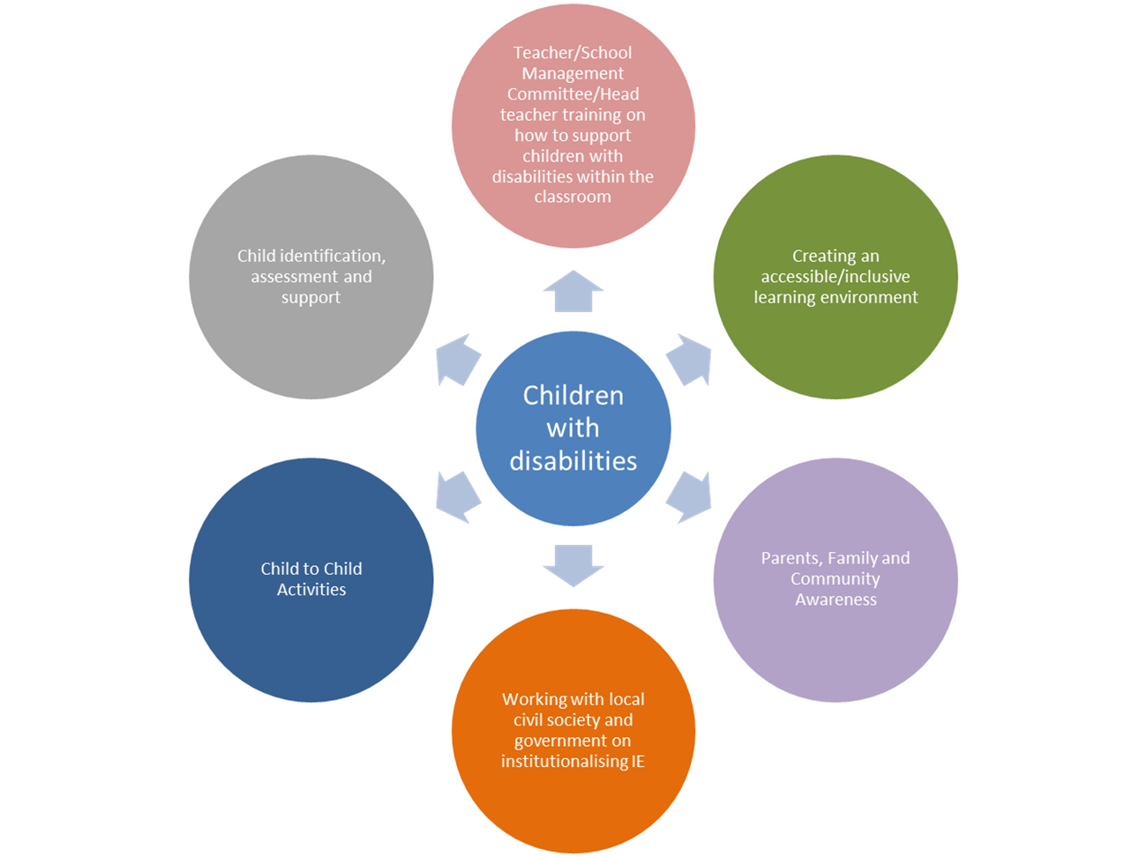
CORE ELEMENTS OF SOCIAL INCLUSION

Slide 6
Core elements of Social Inclusion
Child identification, assessments and support – in-school and out of school children
Rehabilitation and follow up - involves identification and provision of specific child needs in classroom
Partnership with Governments and Teaching Training Institutes
Creating an Accessible Learning Environment – involves physical, material and curriculum adaptations

Slide 7
CORE ELEMENTS OF SOCIAL INCLUSION
Child to Child Activities - Bridges the gap between children with disabilities and their non-disabled peers and it also helps overcome attitudinal barriers to inclusive education
Parents, Family and Community Awareness
Supporting teachers – Pre-service and in service training to teachers on inclusive education

Slide 8
What should teacher training cover
  Background to inclusive education and disability
  Identifying children with disabilities
  Barriers to education
  Individual education plans
  Supporting children in the classroom
  Making inclusive materials
  Child Protection

Slide 9
What we did on the project
Adaptation of the college building
Ramps
Rails
Adaptation of toilets
Purchasing of computers
Installing disability friendly software (JAWS)
Inclusive education training for teachers so they can handle students with disabilities
Adaptation curriculum to accessible formats such as sign language, video, braille, large print
Sign language training

Slide 10
COMMUNITY LEVEL
Disability assessments
Identification of students for enrolment
Community awareness on disability to remove social/ attitudinal barriers
Sign language training

Slide 11
Take Home Points
Every child, regardless of disability has the right to a quality education
LCDZ conscribes to the social/human rights model of disability. Society should adapt to the individual rather than the other way around
There is growing recognition of the importance of inclusive education and its role in sustainable development
Successful inclusion requires a fundamental rethink of school (and learning) cultures to ensure they are flexible and responsive to all students, taking into account the diversity of students’ needs and rights.

Slide 12
Take home points cont’d
  In order to achieve Inclusive Education we need to work on the following levels:
      Individual
      Family/ Community
      Schools
      District
      National
  Child protection is vital to the success of our projects and the wellbeing of the children we work with

Slide 13
Thank you

