Slide 1
PONESAI VANHU TECHNICAL COLLEGE PRESENTATION

Slide 2
ACRONMYS
YWD-Youths with disabilities
SWD-Students with disabilities
LCDZ-Leonard Cheshire Disability Zimbabwe

Slide 3
Social Inclusion /Disability inclusion
Youths with disabilities are among the most disempowered and disadvantages groups in Zimbabwe. Youths with disabilities in most cases are not employed due to various reasons including failure to obtain passes at equal basis with these considered to be normal. Youths with hearing impairment for example fail language due to communication limitations
For the program to move well, LCDZ promoted the management of students with intellectual disabilities and visual impairments. Models of disability were introduced to the students in order to appreciate the background of inclusive education.

Slide 4
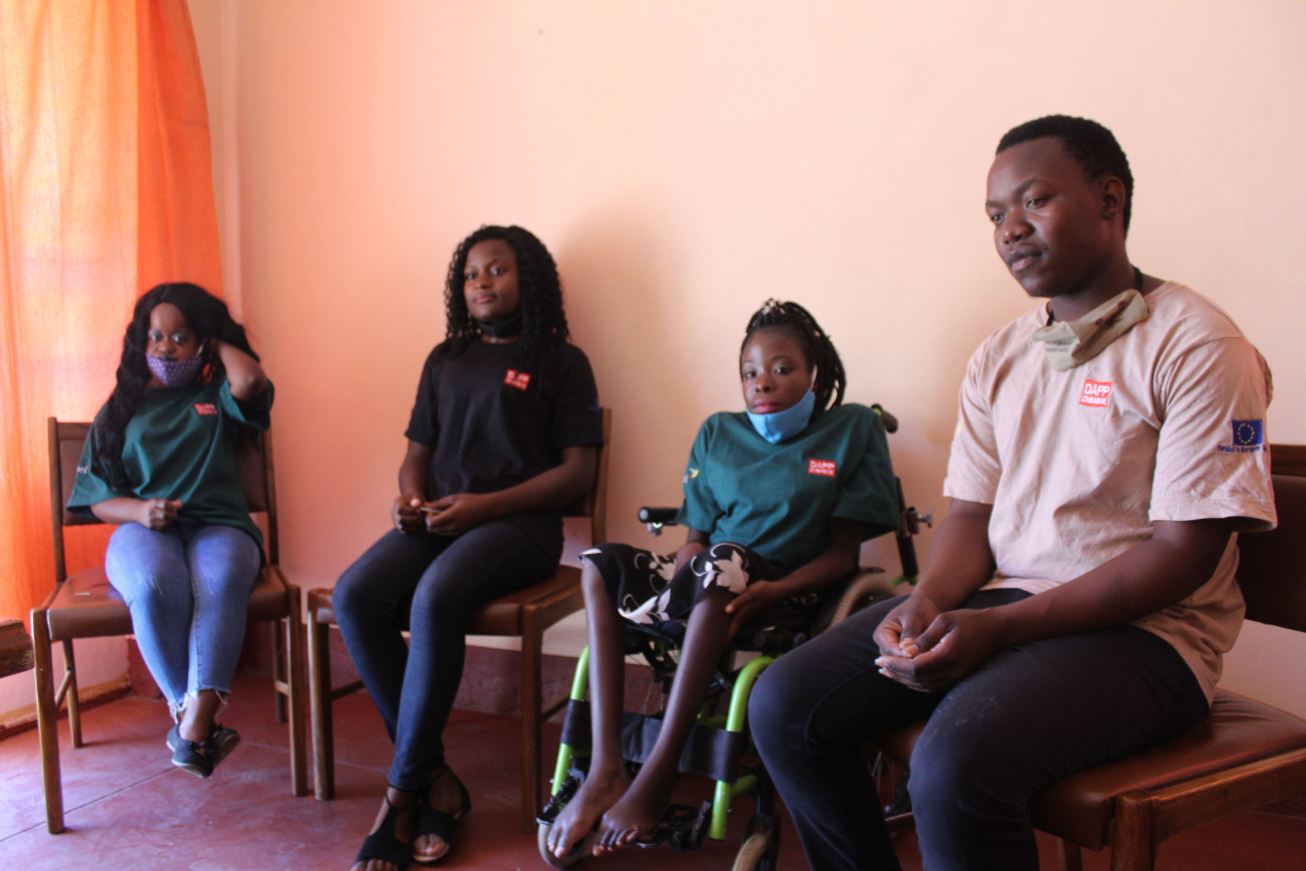
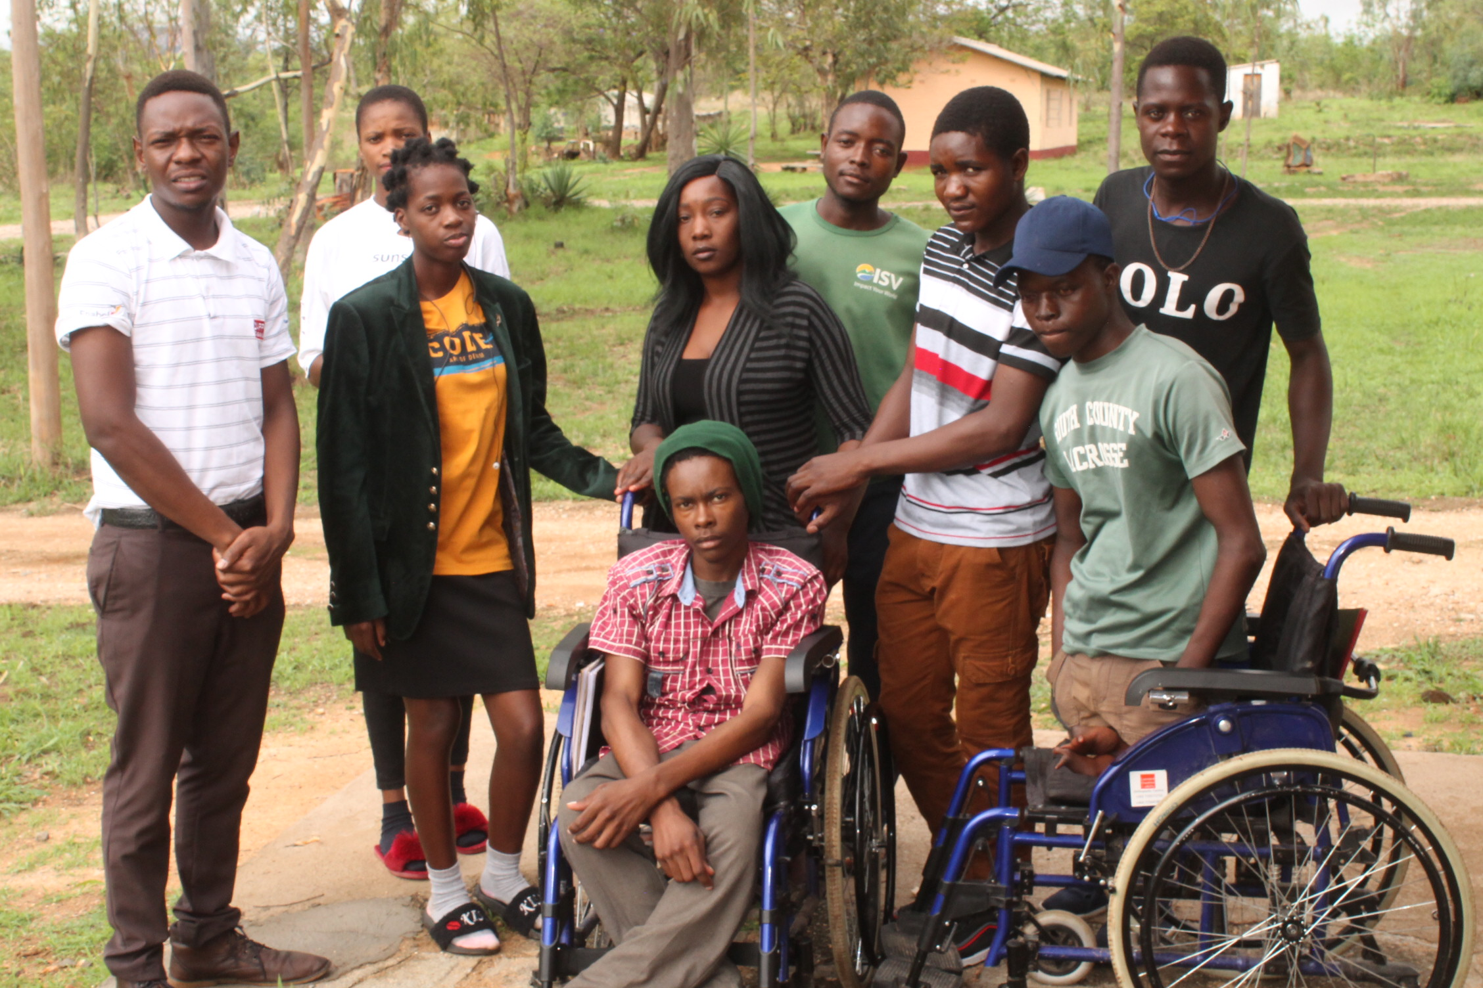

Slide 5
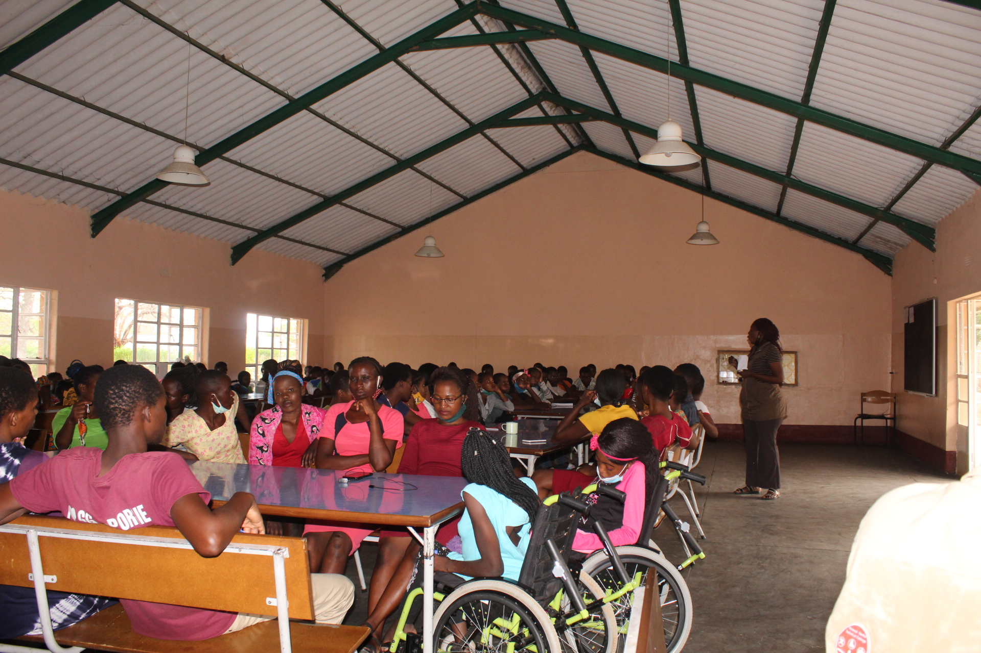
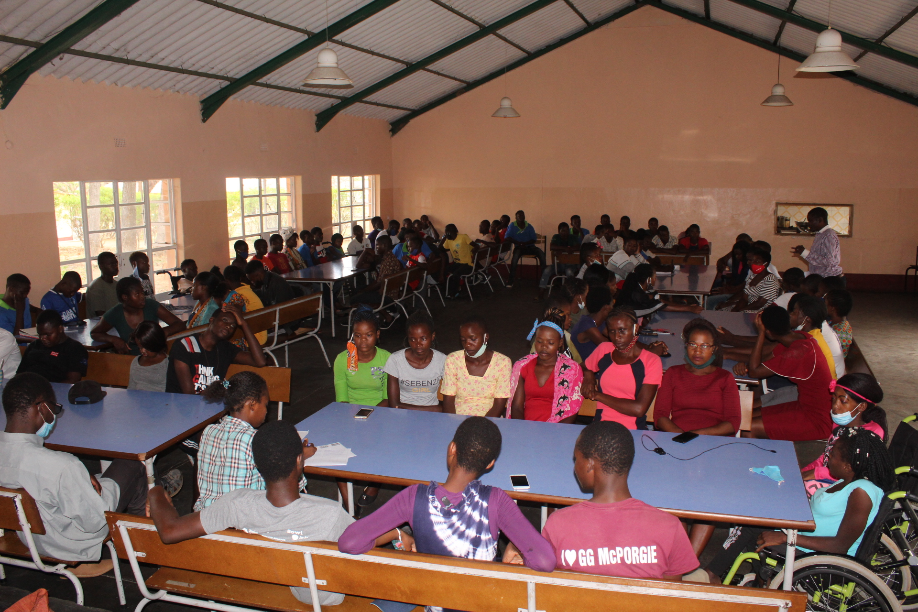

Slide 6
Cont……
In total Ponesai Vanhu and Chaminuka Centres trained 15% of 437 students who were disabled which was 35 . A total of 8% were female students and 7% were male students.
On this aspect the program reached its goal of enrolling 400+ students and 50% were supposed to be females and 50% were supposed to be males. Having achieved 8% for female students compared to 7% for male students means gender equality one of the Sustainable Development goal aspect was addressed. For development to speed up the issue of gender has to be taken into consideration because all along women were looked down upon much more the disabled women. Now TVET came in to correct this error.

Slide 7
Infrastructure adaptation
One clear demand for TVET Program to take off was the improvement of infrastructure for the school. Renovations were done targeting many areas. This move was not just a short term benefit but a long term benefit because after TVET program, youths with disabilities continue to benefit and this eventually has improved our recruitment as a school. Infrastructure adjustments started in December 2019 into February 2020.
The renovations resulted in the
Construction a ramp connecting the dormitories, classrooms and dining hall.
Widening of the the entry doors to classrooms, dormitories, bathrooms and toilets to 1.1meters
Lowering of windows for improved lighting

Slide 8
Cont…
Lowering of sinks and stop cocks to 0.7metres
Installation of mobile shower seats in male and female bathrooms
Added rails at entrances

Slide 9
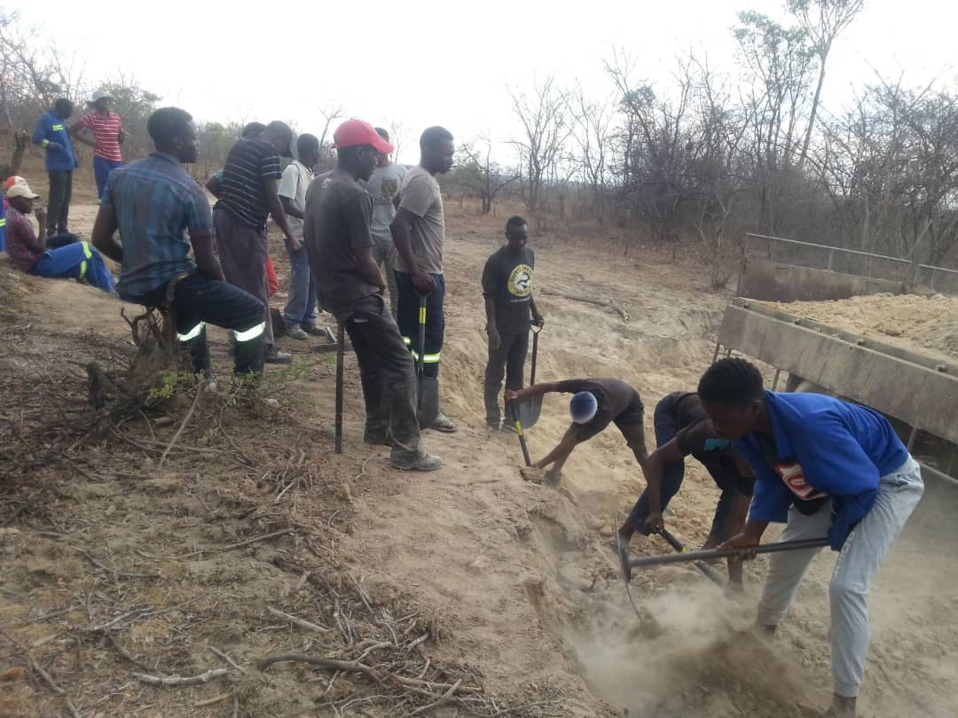
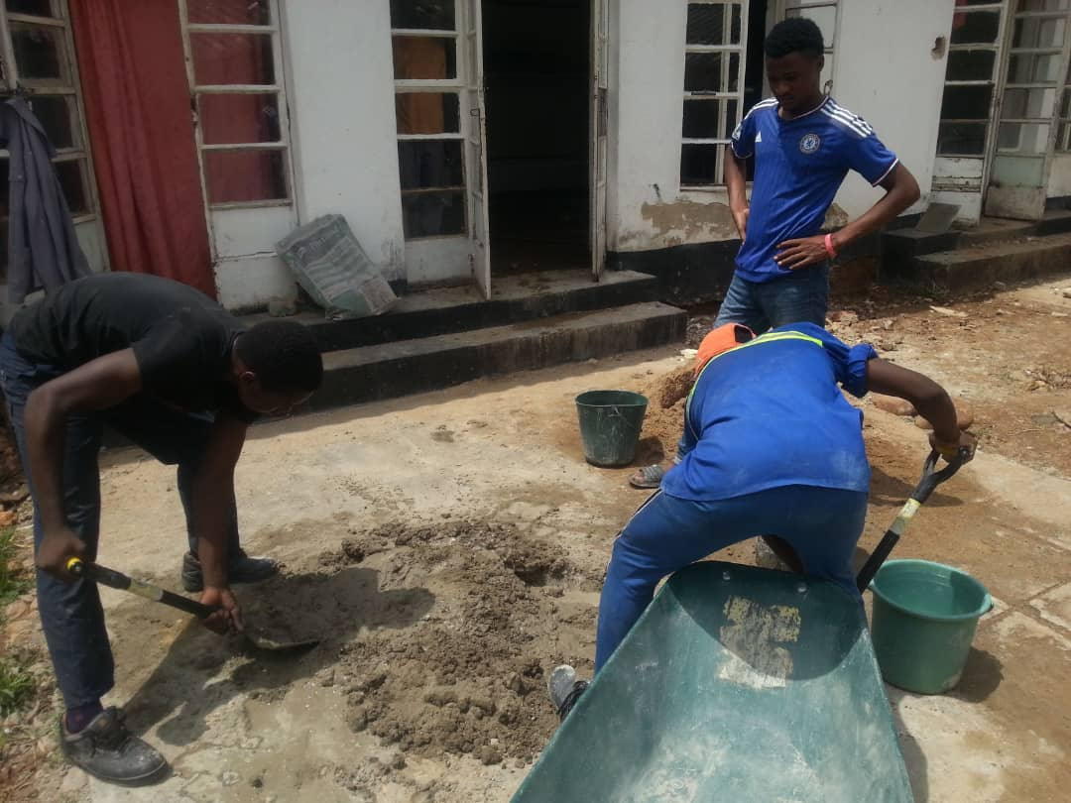
Images for doors for classes, toilets , bathrooms , rumps, and bathing chairs

Slide 10
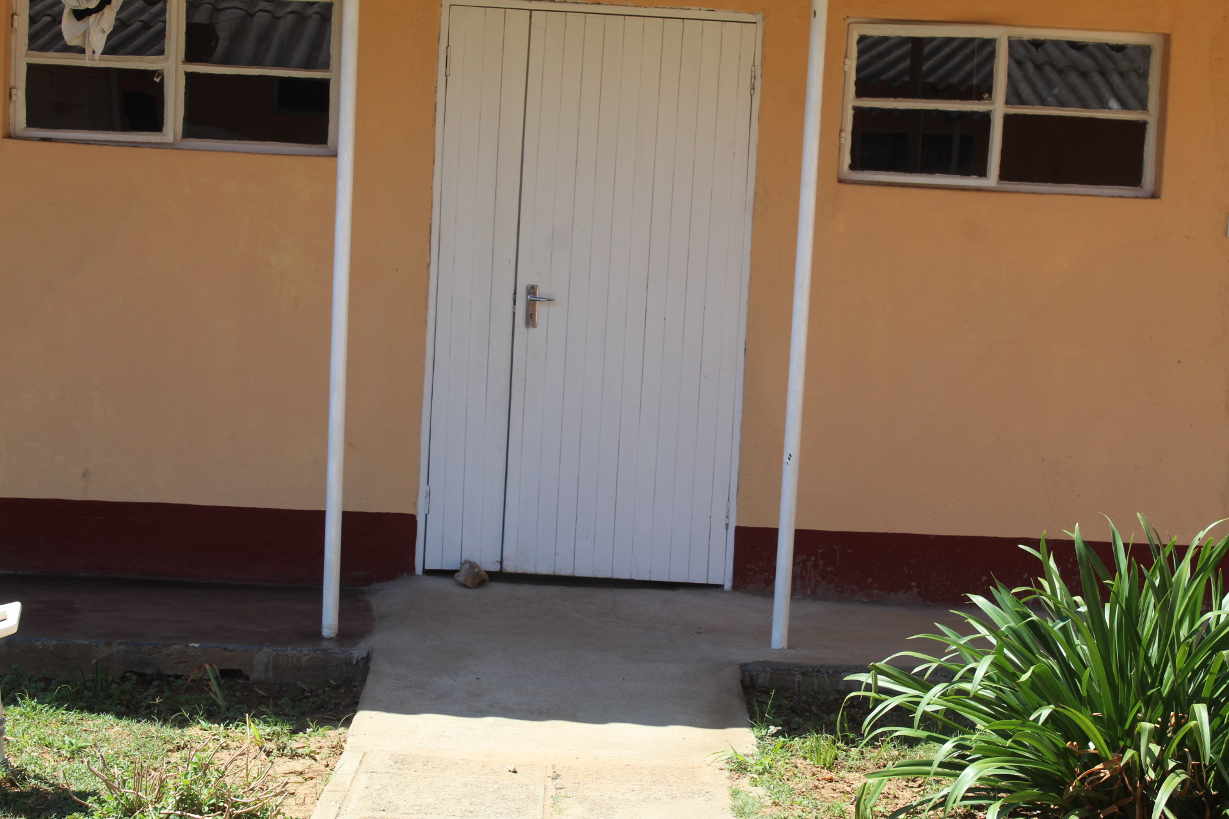
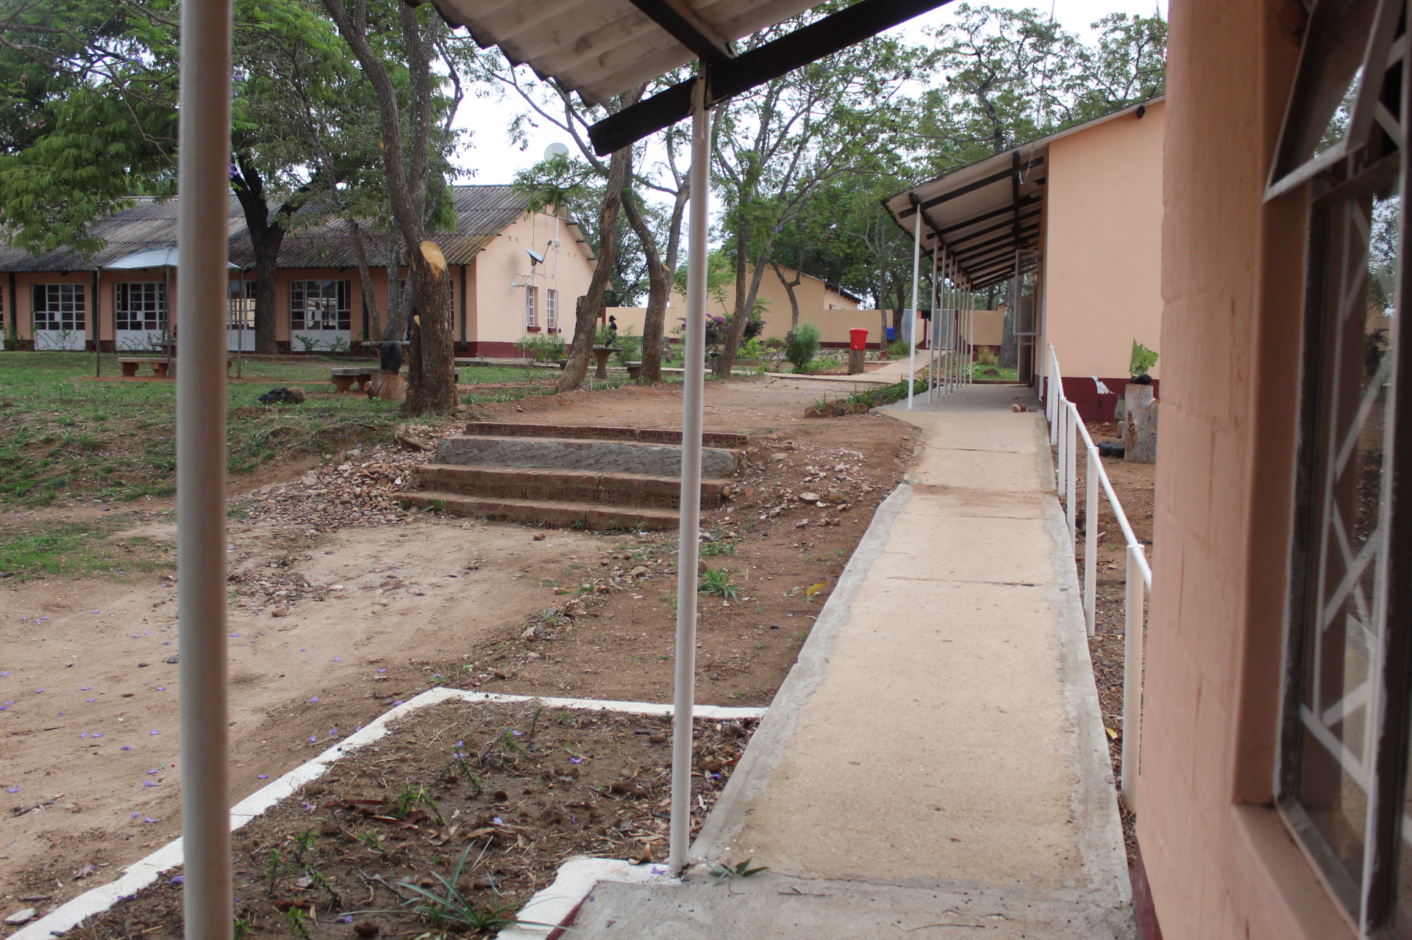

Slide 11
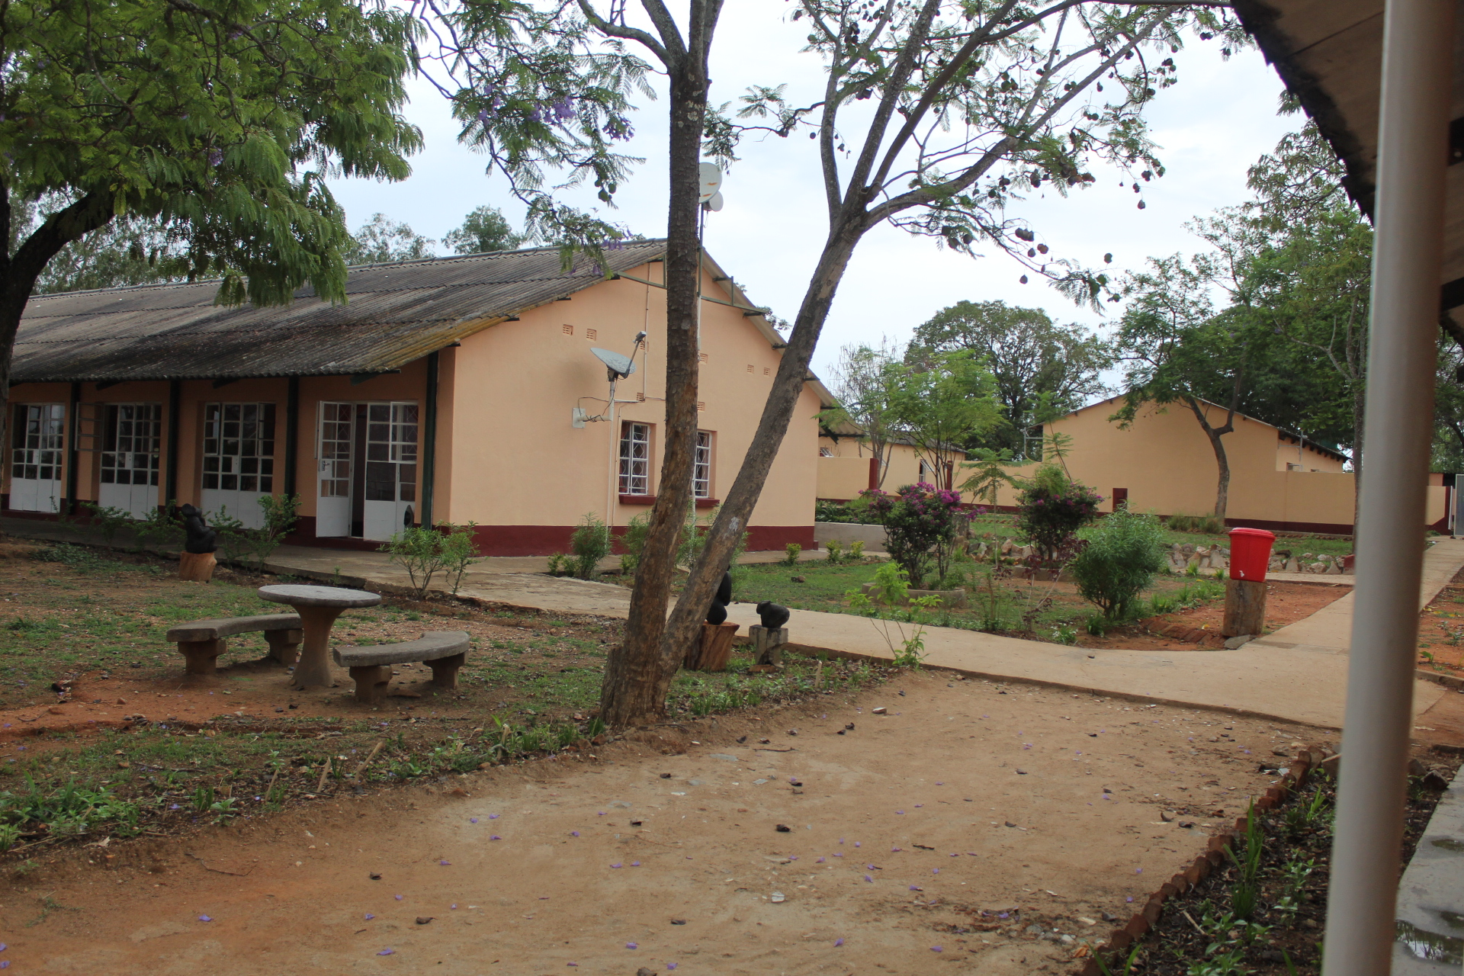
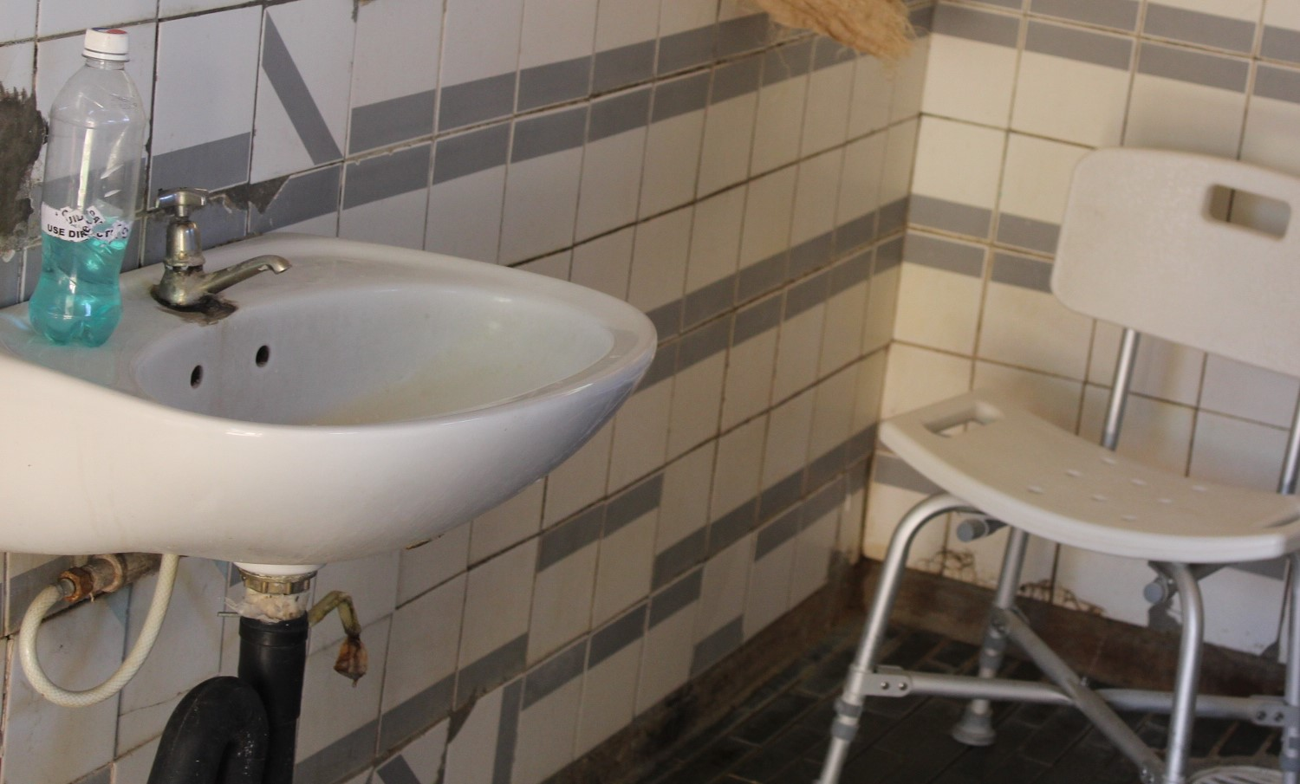

Slide 12
Training Materials Adaptation
LCDZ procured and produced accessible learning material for SWD according to new and updated curricula.
LCDZ provided translation and produced the revised and new curricula in accessible formats which are braille, DVDs with sign language, audiobooks in Mp3 format.
5 sign language DVDs were produced for 5 courses to help students who are deaf and hard of hearing.
5 courses were also converted into audio books in Mp3 and braille for students who are blind and with visual impairment.
LCDZ also purchased assistive devices on demand basis after assessing SWDs at CVTC and PVTC.
NB The training of students with intellectual disabilities and visual impairments was a very good consideration leading to the success of the program. The training started with 15 teachers and thereafter models for teaching students with disability were introduced to the students in order for the teachers and students to appreciate the background of inclusive education. Both students and teachers benefitted

Slide 13
Cont…..
Additionally LCDZ installed 5 computers with a Job Access with Speech (JAWS) software for the benefit of visually impaired SWD. 7 lecturers were trained on how to use JAWS. (A JAW is a screen reader for students who are blind).

Slide 14
Description of the training materials
Braille
This targeted reading and writing using Braille machine as well as Stylus and Stale .It was specially for the blind students.
White can
It was focusing on mobility for the blind students .White can or guides can be used for mobility
Sign Language
It was meant for the teachers to get the basics to speak with the students with challenges of deafness
Compuets- here softwares for the blind were installed in the 5 computers

Slide 15
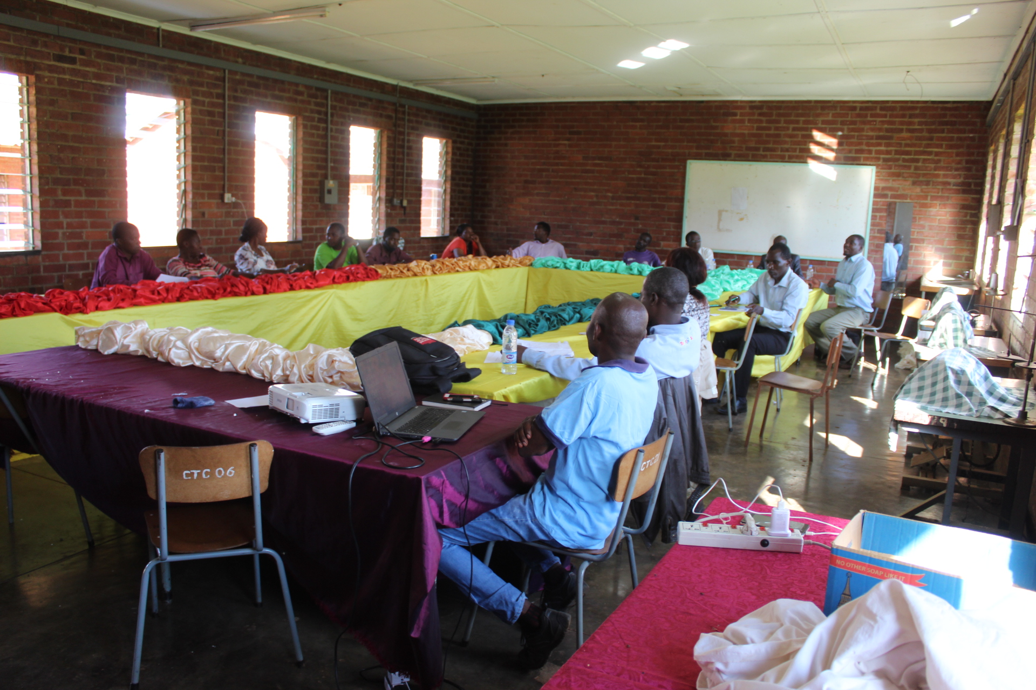
Teachers on training on sign language at Chaminuka Vocational Training centre

Slide 16
Conclusion
We are so happy as DAPP Zimbabwe and in particular as Ponesai Vanhu Technical College to have undertaken this very huge project in partnership with the Belgium Government implementing TVET For All program through Public –Private Partnership in Zimbabwe. We would like to thank all stakeholders who have supported this program to be a success and given the resources again we are ready to take up the second phase.
THANK YOU

