Slide 1



Slide 2
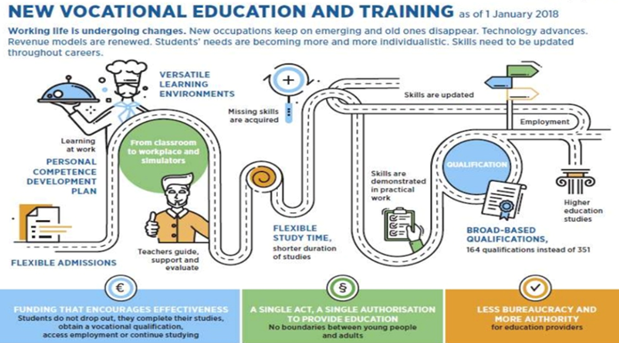

Slide 3


NEW VOCATIONAL EDUCATION AND TRAINING
Working life is undergoing changes. New occupations keep on emerging and old ones disappear. Technology advances. Revenue models are renewed. Students’ needs are becoming more and more individualistic. Skills need to be updated throughout careers.

Slide 4
HOW WE SEE THE CENTRES OF VOCATIONAL EXCELLENCE
Engines for VET development – beacons for VET
reforms
Cases of good vocational schools/providers
(or clusters)
Examples of high commitment to change and improvement
Examples of good partnership between relevant stakeholders

Slide 5
COVES CAN HELP ADDRESS:
Human capital development
Attractiveness and relevance of VET
Global challenges – internationalisation of VET
Globalisation and connectivity
Climate change
Technological and digital change
Demographic shifts

Slide 6
HOW DOES THE COVES INITIATIVE SUPPORT THE ETF STRATEGY 2027

Slide 7
1
HUMAN CAPITAL DEVELOPMENT
Through the development of tools that can support CoVEs to improve skills provision and address effectively local needs – Help make the connection with Smart specialization strategies.

Slide 8
KNOWLEDGE HUB FOR POLICY AND PRACTICE
2
Through the development and management of an international Network of CoVEs. The Network becomes the Hub that collects and disseminates information, knowledge and tools relevant to the development of CoVEs.

Slide 9
3
DELIVERING IN PARTNERSHIP
The ETF international network becomes the new way of cooperating with international organisations, VET providers and the EU. The network itself builds bridges and creates links and partnerships between CoVEs in the EU and beyond.

Slide 10



Selecting countries
NETWORK OF CENTRES OF VOCATIONAL EXCELLENCE
BECOMING EXCELLENT
Mapping
Registry
KNOW-HOW IN COVE DEVELOPMENT
Selecting CoVES

Slide 11
ETF PARTNER COUNTRIES – THE FIRST GROUP OF COUNTRIES TO JOIN ENE

Slide 12
SELECTING COVES FOR ENE
We apply three selection criteria
1 Endorsement by the country
2
What and how (see dimensions)
3
Commitment

Slide 13



WHAT ARE THE EXPECTED OUTPUTS FROM ENE
PEER LEARNING
PARTNERSHIPS
TOOLS

Slide 14
ENE AREAS (DIMENSIONS) OF FOCUS FOR 2020/2022
1
Lifelong learning
2 Education-business collaboration
3 Pedagogy & professional development
4
Smart specialisation

Slide 15
ENE AREAS (DIMENSIONS) OF FOCUS FOR 2020/2022
5
Industry 4.0 and digitalisation
6 Autonomy & Institutional Development
7 Supporting sustainable goals
8
Social inclusion

Slide 16
THE ENE REGISTRY
The ENE Registry is a database containing detailed information about the Centres of Vocational Excellence identified in the 17 ETF partner countries according to the criteria set up by the ETF.
Timing: March – June 2020, finalisation of the first version of the Registry

Slide 17
The Registry serves three main purposes…
1
Informing ETF analysis of current situation and ongoing trends in the development of COVEs in our partner countries
2
Informing ETF and ENE’s members about suitable institutions to form together or join an existing partnership
3
Informing the ETF ENE project about thematic areas to focus on in the medium term.

Slide 18
SELF ASSESSMENT TOOL FOR COVES
Permits ENE members:
To reflect and self-assess to establish a baseline for development in line with selected dimensions.
To establish priorities and set development goals taking into account their own aims and contexts
1
2

Slide 19
SELF ASSESSMENT TOOL FOR COVES
Enables the ENE to:
Identify needs and plan cooperation and support services
Analyze needs and progress by dimension, sector, country or maturity
Evaluate impact of interventions
Develop knowledge
Systematically and explicitly account for the dimensions of excellence
Design and review the framework
Test relevance of framework through application

Slide 20
WHAT ACTIONS ARE FORESEEN THROUGH SUB-INITIATIVES
1
Partnerships, “groups of CoVEs sharing common interests” are central to efforts of CoVEs to achieve excellence.
Typically, CoVEs build and engage in partnerships to use resources efficiently, attract high quality teachers and trainers and produce tools and innovative curricula in niche economic areas.
2

Slide 21
WHAT ACTIONS ARE FORESEEN THROUGH SUB-INITIATIVES
Design an action plan, with objectives, activities, responsibilities and time schedule to be carried out by the partnership members throughout 2020.
Investigate opportunities for peer learning activities (PLA) among
members.
Investigate the production of some kind of tool i.e. a training module, a planning tool or some instructional materials.
Identify and propose relevant opportunities to make applications for EU and other national and international Programmes and schemes, such as Erasmus+, E-Twinning, TAIEX calls.
Explore opportunities linked to Mobility/Learning agreements offered by the EU (and beyond).

Slide 22
HOW ARE ERASMUS PARTNERSHIPS LINKED?
The EU provides funds for the establishment and development of transnational platforms of CoVEs. Platforms are formed by CoVEs, which:
share a common interest in specific sectors or trades (aeronautics, e-mobility, healthcare, tourism, etc.) or
develop innovative approaches to tackle societal, technological and economic challenges (climate change, digitalisation, artificial intelligence, sustainable development goals, integration of migrants, upskilling people with low qualification levels, etc.)
22

Slide 23
HOW ARE ERASMUS PARTNERSHIPS LINKED?
The ETF Network will support partnerships in the following areas:
Lifelong learning in VET – from IVET to CVET and adult education
Industry 4.0 and Digitalisation
Smart specialisation – Mobilising Innovation, ecosystems and SMEs
Going Green – supporting sustainable goals
Education – business collaboration and cooperation
Autonomy and Institutional development (financing, leadership, governance)
Pedagogy and professional development
Social cohesion
23

Slide 24
SUB-INITIATIVE 1 – PARTNERSHIP ON WORK-BASED LEARNING
How can CoVEs support work-based learning?
1
  Partnership with CoVEs in the Baltic countries
  Organisation of two peer learning activities (Latvia and Estonia in 2021)
  Tool development: baseline study & evaluation of progress (following coaching sessions)
2
3

Slide 25
SUB-INITIATIVE 1 – PARTNERSHIP ON WORK-BASED LEARNING
Progress and way forward
Partnership signed with the Latvian Vocational Education Association
6 ETF Partner Countries (PCs) selected, by responding to defined criteria: Albania, Armenia, Belarus, Moldova, North Macedonia and Kazakhstan
12 representatives from schools or VET National Agencies appointed to be part of the initiative, 2 from each of the selected 6 ETF PCs
2 Peer learning activities to be implemented by 2021:
Latvia and Estonia

Slide 26
SUB-INITIATIVE 1 – PARTNERSHIP ON WORK-BASED LEARNING
Progress and way forward
12 on-line coaching sessions for participating CoVEs from selected ETF PCs
6 coaching missions and on-site advice/coaching in ETF PCs
6 CoVEs from the 6 selected PCs will have the opportunity to undertake:
  A Baseline study: each CoVE can map its current WBL practices (find out where it stands) and analyse opportunities for development
  An evaluation of progress: measuring progress made by each CoVE → 6 case studies to be developed

Slide 27

SUB-INITIATIVE 2 – institutional partnership with other institutions
Joining forces with VET providers
Peer Learning Clubs with Skillman on Work Based learning and Teachers professional development
Policy brief and peer learning actions on Digitalisation
CoVEs from Partner countries will have the opportunity to cooperate with other CoVEs with similar needs, which are part of Skillman Network

Slide 28

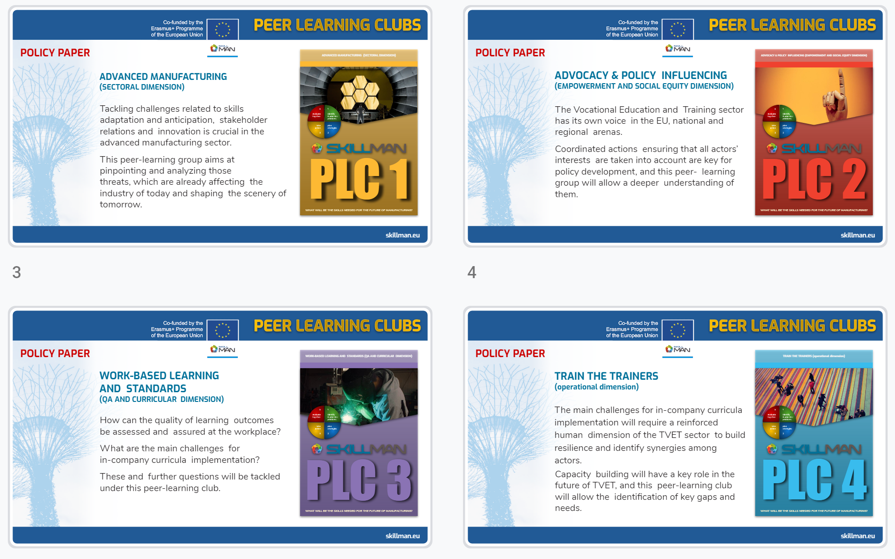
isbn 9788887156157
isbn 9788887156164
isbn 9788887156171
isbn 9788887156188

Slide 29
SUB-INITIATIVE 3 – PARTNERSHIP ON AUTONOMY OF COVEs
Institutional development
VET and skills public private partnerships
Autonomy
Sharing practice and know-how
Evaluating learning outcomes
COVES Community of Practice
VET and skills for the labour market

Slide 30
Smart Specialisation – Links with ENE
1
ETF activity, Montenegro and Moldova, 2020 (in editing) - we are wrapping up the methodology and the reports and aiming for them to be publicly launched during skills week.
ETF activity, Ukraine 2 regions, 2020 (ongoing) - continuation of what started in Montenegro and Moldova – but at regional level in 2 pilot regions. This time, zooming into regions (Kharkiv and Zaporizhnya), we will put more emphasis on regional ecosystems and the role of vocational schools and centres – and link it to SMEs. Experts have started desk research.
ETF publication - article on skills for smart specialisation will incorporate the role of CoVEs.
2
3

Slide 31
Smart Specialisation – Links with ENE
4
ETF paper for ENRLMM (European network on labour market monitoring). ETF will ook at how CoVEs can address SME training, capacity and innovations constraints – and facilitate their move to value added activities. For most SMEs it is more fitting to their absorptive capacity to seek collaboration with vocational schools rather than with academic partners.
Input on skills for Smart Specialisation which is a dimension in the self assessment tool for CoVEs
5

Slide 32
INDICATIVE TIMETABLE FOR DELIVERABLES IN 2020
04-05/20
Creation of database/Registry and selection of CoVEs for ENE
02/20
Letter to relevant ministers of the 17 partner countries
03/20 Collection of replies from partner countries
04/20 Launch of 1st sub-initiative (partnership) on work-based learning
04/20
Launch of 2nd sub-initiative (institutional partnership)

Slide 33
INDICATIVE TIMETABLE Contd.
05-06/20
Consultation and test of Research Framework for Dimensions of Excellence
06/20
ETF publication on CoVEs - An engine for VET development?
06/20
Launch of 3rd sub-initiative (partnership) on autonomy of CoVEs and public private partnerships
11-12/20 Peer learning activities on Work based learning in CoVEs
End 2020
Launch conference of ENE (place to be decided)

Slide 34


Keep up to date
On the web
On OpenSpace
On Twitter
On FaceBook

